Slide 1


Modern Operating Systems
Fifth Edition
Chapter 3
Memory Management
Copyright © 2023, 2014, 2008 Pearson Education, Inc. All Rights Reserved
Notes:
If this PowerPoint presentation contains mathematical equations, you may need to check that your computer has the following installed:
1) Math Type Plugin
2) Math Player (free versions available)
3) NVDA Reader (free versions available)

Slide 2
Memory (1)
Paraphrase of Parkinson’s Law:
Programs expand to fill the memory available to hold them.
My laptop with 32G B of R A M has 20,000 times more memory than the I B M 7094 (32768 words of 36 bits)─the largest computer in the world in the early 1960s. And my laptop is always full.

Slide 3
Memory (2)
Memory Abstractions
Virtual Memory
Page Replacement Algorithms
Design Issues for Paging Systems

Slide 4
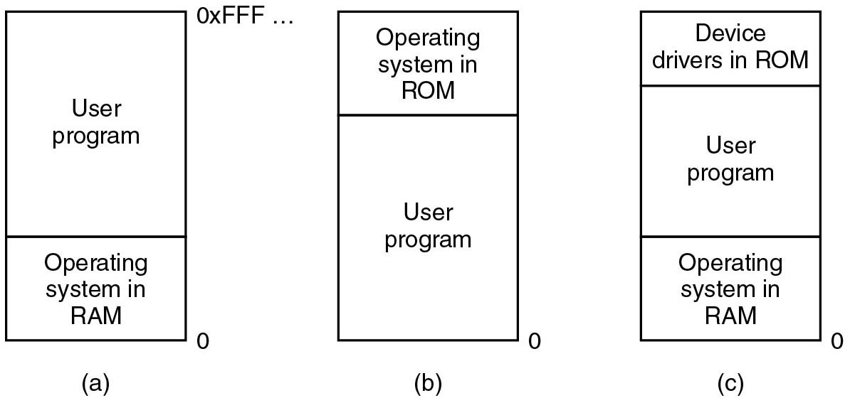
No Memory Abstraction: Monoprogramming (1)
Figure 3.1 Three simple ways of organizing memory with an operating system and one user process.
Notes:
Long Description:
A zero is marked next to the lower right end of all three blocks.
Block "a": The block is divided into two segments labeled user program and operating system in R A M.
Block b: The block is divided into two segments labeled operating system in R O M and user program.
Block c: The block is divided into three segments labeled device drivers in R O M, user program and operating system in R A M.

Slide 5
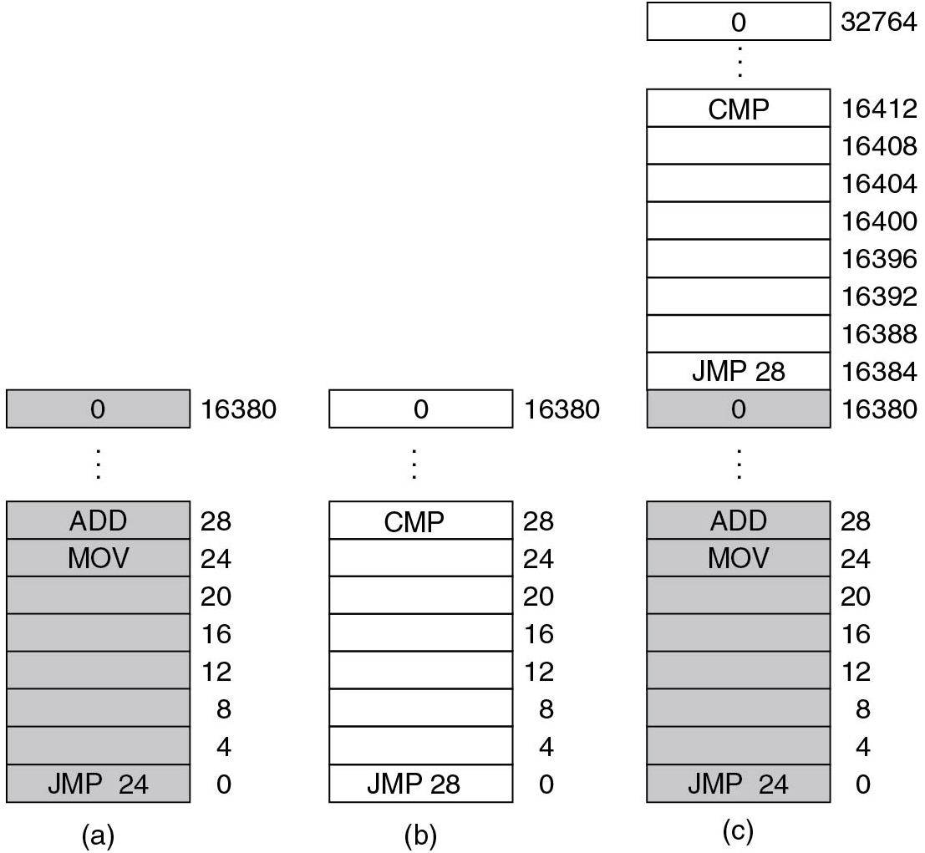
No Memory Abstraction: Multiprogramming (2)
Naive approach:
Move each program to a dedicated region
Figure 3.2 Relocation problem. Two 16 K B programs loaded consecutively into memory.
Notes:
Long Description:
Part a: The block consists of 4095 shaded rows with address space labeled from bottom to top as 0, 4, 8, 12, 16, 24, 28, up to 16380. The rows having address space 0, 24, 28, and 16380 are labeled J M P 24, M O V, ADD, 0, respectively.
Part b: The block consists of 4095 unshaded rows with address space labeled from bottom to top as 0, 4, 8, 12, 16, 20, 24, 28, up to 16380. The row having address space 0, 28, and 16380 are labeled J M P 28, C M P, and 0, respectively.
Part c: The block consists of 8191 rows with address space labeled from bottom to top as 0, 4, 8, 12, 16, 20, 24, 28, up to 16380, and then 16384, 16388, 16392, 16396, 16400, 16404, 16408, 16412, up to 32764. The rows having address space 0, 24, 28, 16380, 16384, 16412 and 32764 are labeled as follows: J M P 24, MOV, ADD, 0, J M P 28, C M P, and 0.

Slide 6
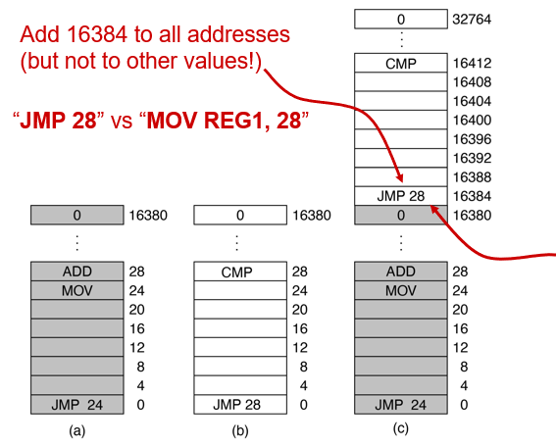
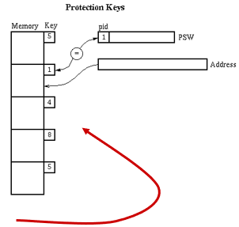
No Memory Abstraction: Multiprogramming
Naive approach:
Move each program to a dedicated region
Problems:
Relocation
Load-time?
Protection
Memory keys?
Figure 3.2 Relocation problem. Two 16 K B programs loaded consecutively into memory.
Notes:
Long Description1:
The first illustration is labeled as a in parenthesis. It shows a grey rectangle with 0 written on it and labeled as 1 6 3 8 0 on the right. Vertical three dots follows the rectangle. Below the dots, there is a rectangle divided into 8 sections from top to bottom. ADD and M O V is written on the top two sections while J M P 24 is written on the bottom section. The labelings of each section from top to bottom on the right side are 28, 24, 20, 16, 12, 8, 4, and 0. The second illustration is labeled as b in parenthesis. It shows a rectangle with 0 written on it and labeled as 1 6 3 8 0 on the right. Vertical three dots follows the rectangle. Below the dots, there is a rectangle divided into 8 sections from top to bottom. C M P is written on the top section while J M P 28 is written on the bottom section. The labelings of each section from top to bottom on the right side are 28, 24, 20, 16, 12, 8, 4, and 0. The third illustration is labeled as c in parenthesis. It shows a rectangle with 0 written on it and labeled as 3 2 7 6 4 on the right. Vertical three dots follows the rectangle. Below the dots, there is a rectangle divided into 8 sections from top to bottom. C M P is written on the top section while J M P 28 and 0 are written on the bottom two sections. The labelings of each section from top to bottom on the right side are 1 6 4 1 2, 1 6 4 0 8, 1 6 4 0 4, 1 6 4 0 0, 1 6 3 9 6, 1 6 3 9 2, 1 6 3 8 8, 1 6 3 8 4, and 1 6 3 8 0. Two squiggly arrows point from opposite direction toward the section in which J M P 28 is written. Vertical three dots follows the rectangle. Below the dots, there is a rectangle divided into 8 sections from top to bottom. ADD and M O V is written on the top two sections while J M P 24 is written on the bottom section. The labelings of each section from top to bottom on the right side are 28, 24, 20, 16, 12, 8, 4, and 0.
Long Description2:
The left part of the illustration shows memory and key. Memory are shown by five square boxes while keys are labeled for each box from top to bottom as 5, 1, 4, 8, and 5. The right part of the illustration has two rectangles. The first rectangle is labeled as P S W. It also has a section labeled as p i d 1. It is connected to key 1 of left part with the help of a pointer. The second rectangle is labeled as address. It is shown by a pointer pointing to memory of the left part of the illustration.

Slide 7
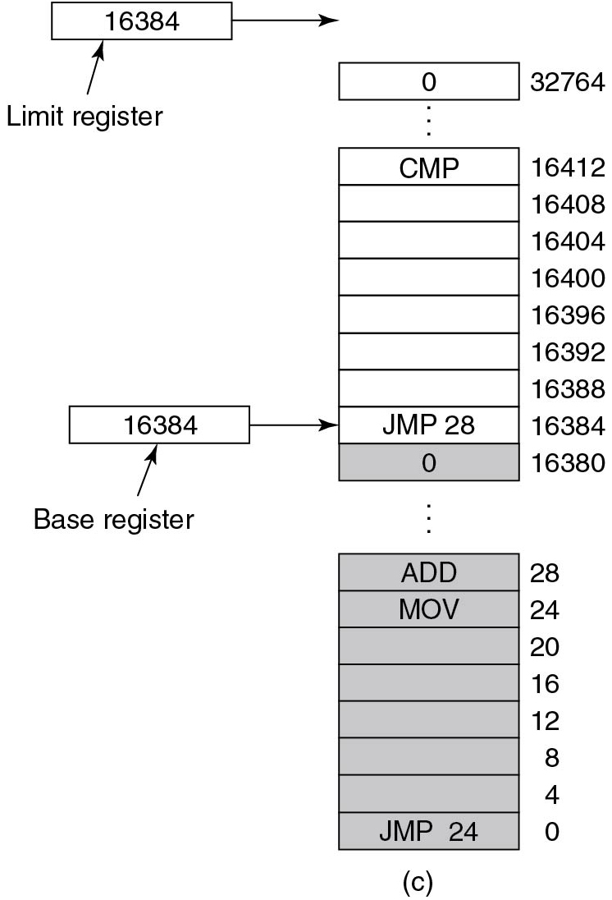

Memory Abstraction: Address Spaces
Base register operates dynamic relocation
Limit register enforces protection
Checks for M O V Reg1, Addr:
Figure 3.3 Base and limit registers
Notes:
Long Description1:
The block consists of 8191 rows having address space labeled from bottom to top as 0, 4, 8, 12, 16, 20, 24, 28, up to 16380, and then 16384, 16388, 16392, 16396, 16400, 16404, 16408, 16412, up to 32764. The rows 0, 4, 8, 12, 16, 20, 24, 28, 16380, 16384, 16412, and 32764 are labeled J M P 24, MOV, ADD, 0, J M P 28, C M P and 0, respectively. Half of the number of rows from the bottom are shaded. The limit register with address space 16384 points above the top row of the block and the base register with address space 16384 points to the row labeled J M P 28.
Long Description2:
The code from top to bottom is as follows.
IF left parenthesis Addr is greater than LIMIT right parenthesis implies NOT OKAY
IF left parenthesis BASE plus Addr is less than BASE right parenthesis implies NOT OKAY.

Slide 8
What If We Run Out of Memory?
Simplest solution: swapping of processes
bring in entire process, run it for a while, then put it back on disk/S S D
Idle processes do not take up any memory when they are not running
Alternative: virtual memory
We will discuss this later!

Slide 9
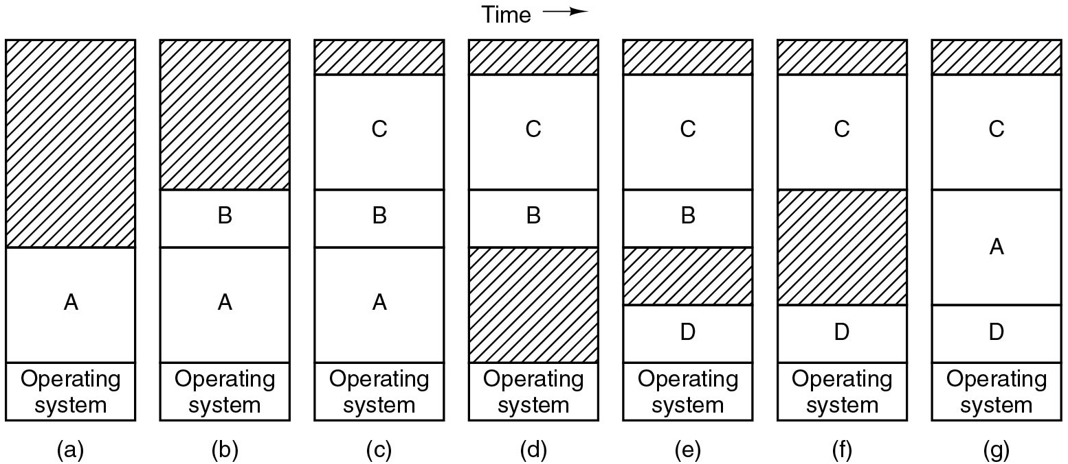
Improvement: Dynamic Partitions and Swapping (1)
Swapping may lead to memory fragmentation
Memory
compaction
Figure 3.4 Memory allocation changes as processes come into memory and leave it.
Notes:
Long Description:
The figure consists of seven vertical blocks labeled a, b, c, d, e, f and g which are given on time axis.
Block a: The block is divided into three segments with increasing size from the bottom. The bottom segment is labeled operating system and the middle segment is labeled "A". The top segment is the largest and is shaded.
Block b: The block is divided into four segments and labeled from top to bottom as follows: Blank, B, A, Operating system. The top segment is shaded.
Block c: The block is divided into five segments and labeled from top to bottom as follows: Blank, C, B, A, Operating system. The top segment is shaded.
Block d: The block is divided into five segments and labeled from top to bottom as follows: Blank, C, B, blank, Operating system. The first and fourth segments are shaded.
Block e: The block is divided into five segments and labeled from top to bottom as follows: Blank, C, B, blank, D, Operating system. The first and fourth segments are shaded.
Block f: The block is divided into five segments and labeled from top to bottom as follows: Blank, C, blank, D, Operating system. The first and third segments are shaded.
Block g: The block is divided into five segments and labeled from top to bottom as follows: Blank, C, A, D, Operating system. The top segment is shaded.

Slide 10
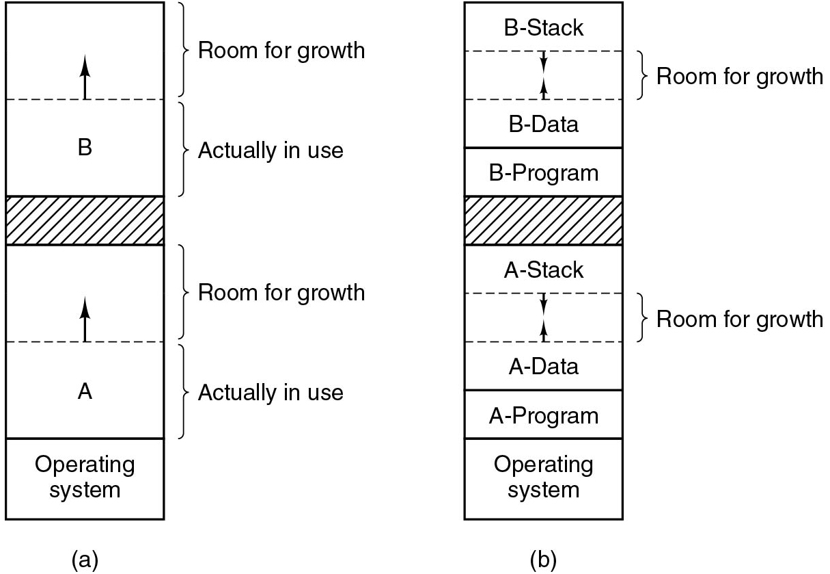
Improvement: Dynamic Partitions and Swapping (2)
Problem:
We need to allow extra room for process growth
Issues:
How much extra room?
Mem usage versus. O O M (Out-Of-Memory) risk
What to do on O O M s?
Kill process
Relocate process
Swap out
Figure 3.5 Allocating space for… (a) … growing data segment
(b) … growing stack + growing data segment
Notes:
Long Description:
Part (a): The block is divided into six segments. The first and second segments, and the fourth and fifth segments from the top are divided by a dashed line. An arrow points upward from the dashed line. The third segment from the top is shaded. The second, fifth and sixth segments are labeled A, B, and Operating system, respectively. The first and fourth segments are marked room for growth while the second and fifth segments are marked actually in use.
Part b: The block is divided into 10 segments. The first and second, second and third, sixth and seventh, seventh and eighth segments are divided by a dashed line. Two arrows point toward each other in the second and seventh segment. The segments are labeled from top to bottom as follows: B stack, room for growth, B data, B program, blank, A stack, room for growth, A data, A program, Operating system. The fifth segment is shaded.

Slide 11
Memory Management
Question: Which part of the memory is allocated?
Divide memory in blocks
e.g. each block is 4 bytes
Solution 1: Bitmap keeps track of which blocks are allocated
Solution 2: Linked list keeps track of unallocated memory

Slide 12
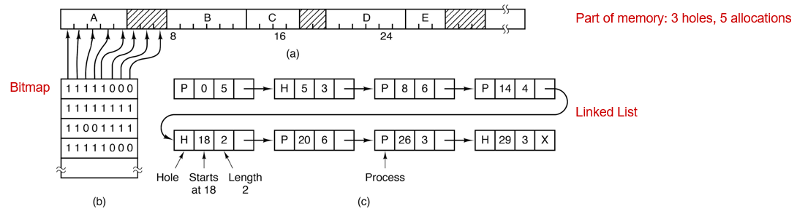
Memory Management: Bitmaps versus Linked Lists
Bitmap: finding holes requires (slow) scanning
List: common versus. separate process/hole lists
Slow allocation versus. slow deallocation
Holes sorted by address for fast coalescing
Notes:
Long Description:
The first part of the illustration is labeled as a in parenthesis. It shows a rectangle divided into 9 sections. The first, third, fourth, sixth, and seventh sections from left to right are labeled as A, B, C, D, and E. The second, fifth, and eighth sections are marked by inclined parallel lines. These eight sections are divided into 32 equal markings. The labeling on the right side reads part of memory: 3 holes, 5 allocations. The second part of the illustration is labeled as b in parenthesis. It shows a rectangle divided into 5 sections from top to bottom. The labelings on each section from top to bottom are 1 1 1 1 1 0 0 0, 1 1 1 1 1 1 1 1, 1 1 0 0 1 1 1 1, and 1 1 1 1 1 1 0 0. The labeling on the left side reads bitmap. The first eight markings from the first illustration are pointed out by each number on the labelings of the second illustration. The third part of the illustration is labeled as c in parenthesis. It shows eight rectangles which are divided into 4 equal sections. The first three sections of the first rectangle are labeled P, 0, and 5, the second rectangle is H, 5, and 3, the third rectangle is P, 8, and 6, the fourth rectangle is P, 14, and 4, the fifth rectangle is H, 18, and 2, the sixth rectangle is P, 20, and 6, the seventh rectangle is P, 26, and 3, and the eighth rectangle is H, 29, 3, and X. The first section of the fifth is pointed out by an arrow labeled as the hole, the second section by an arrow labeled as starts at 18, and the third section by an arrow labeled as length 2. The first section of the seventh rectangle is pointed by an arrow labeled a process. The labeling on the right side reads linked list.

Slide 13
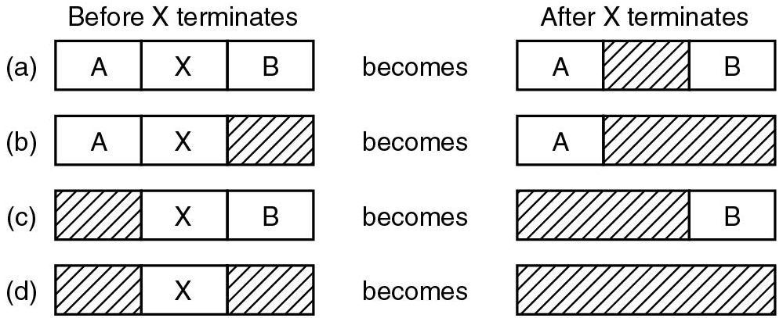
Memory Management with Linked Lists
Figure 3.7 Four neighbor combinations for the terminating process, X.
In practice, a doubly linked is often used
makes freeing easy
Can easily check if previous free
Can easily adjust the pointers
Notes:
Long Description:
The figure consists of four parts and eight horizontal blocks.
Part "a": The block labeled before X terminates contains 3 sections labeled A, X, B becomes the block labeled After X terminates containing 3 sections labeled A, blank (shaded), B.
Part b: The block labeled before X terminates contains 3 sections labeled A, X, blank (shaded) becomes the block labeled After X terminates containing 2 sections labeled A, blank (shaded).
Part c: The block labeled before X terminates contains 3 sections labeled blank (shaded), X, B becomes the block labeled after X terminates contains 2 sections labeled blank (shaded), B.
Part d: The block labeled before X terminates contains 3 sections labeled blank (shaded), X, blank (shaded) becomes the block labeled After X terminates which is completely shaded.

Slide 14
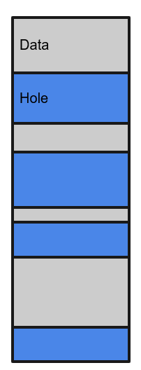
Memory Allocation Schemes
First Fit: Take first fitting hole (M I N I X 3)
Simplest option
Next Fit: Take next fitting hole
Slower than first fit in practice
Best Fit: Take best fitting hole
Prone to fragmentation
Worst Fit: Take worst fitting hole
Poor performance in practice
Quick Fit: Keep holes of different sizes
Poor coalescing performance
Buddy allocation scheme (Linux)
Improves quick fit’s coalescing performance

Slide 15
Extra material
The next few slides contain information that is not found in Chapter 3. It illustrates how memory allocators work in practice, in this case, in an operating system such as Linux. You can find some of this information in Sec. 10.4.

Slide 16
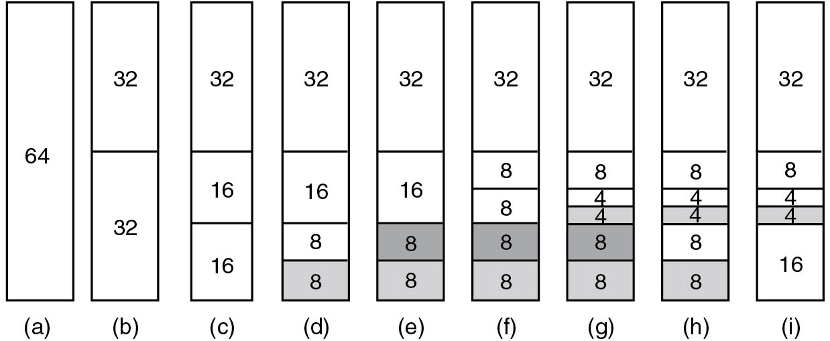
Buddy Memory Allocation
Extra material. See also: Sec.10.4
Originally: one area of size 64 “chunks”
Figure 10.17 Operation of the buddy algorithm
Notes:
Long Description:
The figure consist of nine vertical blocks which are labeled (a), (b), (c), (d), (e), (f), (g), (h) and (i). The first vertical block is labeled 64. The second block is divided into two parts and labeled 32 and 32. The third block is divided into two parts, the first part is labeled 32 and the second part is again divided into two parts which are labeled 16 and 16. The fourth block is divided into two parts, the first part is labeled 32 and the second part is again divided into two parts which are labeled 16, and the other part is again divided into two parts which are 8 and 8 in which one part is shaded. The fifth block is divided into two parts, the first part is labeled 32, and the second part is again divided into two parts which are labeled 16 and the other part is again divided into two parts which are 8 and 8 in the last two parts are shaded. The sixth block is divided into two parts, the first part is labeled 32 and the second part is again divided into four parts labeled 8, 8, 8, and 8 in which the last two parts are shaded. The seventh block is divided into two parts, the first part is labeled 32, and the second part is again divided into four parts, the first part is labeled 8, the second part is again subdivided into two parts labeled 4 and 4, the third part is labeled 8 and the fourth part is labeled 8 and last three parts are shaded. The eighth block is divided into two parts, the first part is labeled 32, and the second part is again divided into four parts, the first part is labeled 8, the second part is again subdivided into two parts labeled 4 and 4 which is shaded, the third part is labeled 8 and the fourth part is labeled 8 and shaded. The ninth block is divided into two parts, first, part is labeled 32 and the second part is again divided into two parts, the first part is again subdivided into two parts labeled 8 and the next part is subdivided into two parts labeled 4 and 4 which is shaded, the third part is labeled 16.

Slide 17
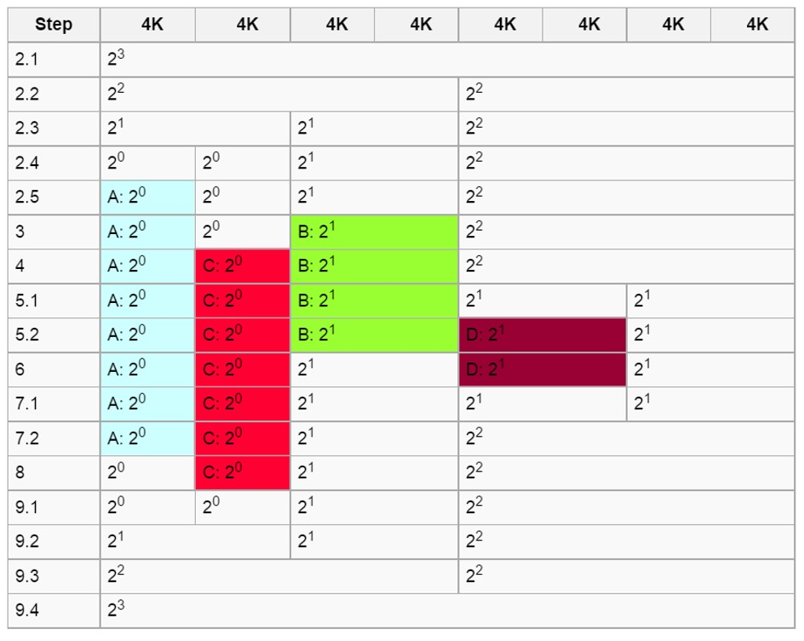
Buddy Memory Allocation (Based on Wikipedia Example) (1 of 3)
https://en.wikipedia.org/wiki/Buddy_memory_allocation
Notes:
Image simplified version of: https://upload.wikimedia.org/wikipedia/commons/thumb/a/a7/Buddyexample.png/640px-Buddyexample.png
This allocation could have occurred in the following manner
The initial situation.
Program A requests memory 3K, order 0.
No order 0 blocks are available, so an order 3 block is split, creating two order 2 blocks.
Still no order 0 blocks available, so the first order 2 block is split, creating two order 1 blocks.
Still no order 0 blocks available, so the first order 1 block is split, creating two order 0 blocks.
Now an order 0 block is available, so it is allocated to A.
Program B requests memory 6 K, order 1. An order 1 block is available, so it is allocated to B.
Program C requests memory 2 K, order 0. An order 0 block is available, so it is allocated to C.
Program D requests memory 6 K, order 1.
No order 1 blocks are available, so an order 2 block is split, creating two order 1 blocks.
Now an order 1 block is available, so it is allocated to D.
Program B releases its memory, freeing one order 1 block.
Program D releases its memory.
One order 1 block is freed.
Since the buddy block of the newly freed block is also free, the two are merged into one order 2 block.
Program A releases its memory, freeing one order 0 block.
Program C releases its memory.
One order 0 block is freed.
Since the buddy block of the newly freed block is also free, the two are merged into one order 1 block.
Since the buddy block of the newly formed order 1 block is also free, the two are merged into one order 2 block.
Since the buddy block of the newly formed order 2 block is also free, the two are merged into one order 3 block.
Since the buddy block of the newly formed order 3 block is also free, the two are merged into one order 4 block.
Long Description:
The table has 9 columns and 17 rows. The column headings are as follows from left to right. Step, 4 K, 4 K, 4 K, 4 K, 4 K, 4 K, 4 K, 4 K, and 4 K. The row entries are as follows from left to right. Row 1: Step, 2 point 1; 4 K, 2 cubed. Row 2: Step 2 point 2; 4 K, 2 squared; 4 K, 2 squared. Row 3: Step, 2 point 3; 4 K, 2 to the first power; 4 K, 2 to the first power; 4 K, 2 squared. Row 4: Step, 2 point 4; 4 K, 2 to the zero power; 4 K, 2 to the zero power; 4 K, 2 to the first power; 4 K, 2 squared. Row 5: Step, 2 point 5; 4 K, A: 2 to the zero power; 4 K, 2 to the zero power; 4 K, 2 to the first power; 4 K, squared. Row 6: Step, 3; 4 K, A colon 2 to the zero power; 4 K, 2 to the zero power; 4 K, B colon 2 to the first power; 4 K, 2 squared. Row 7: Step, 4; 4 K, A colon 2 to the zero power; 4 K, C colon 2 to the zero power; 4 K, B colon 2 to the first power; 4 K, 2 squared. Row 8: Step, 5 point 1; 4 K, A colon 2 to the zero power; 4 K, C colon 2 to the zero power; 4 K, B colon 2 to the first power; 4 K, 2 to the first power; 4 K, 2 to the first power. Row 9: Step, 5 point 2; 4 K, A colon 2 to the zero power; 4 K, C colon 2 to the zero power; 4 K, B colon 2 to the first power; 4 K, D colon 2 to the first power; 4 K, 2 to the first power. Row 10: Step, 6; 4 K, A colon 2 to the zero power; 4 K, C colon 2 to the zero power; 4 K, 2 to the first power; 4 K, D colon 2 to the first power; 4 K, 2 to the first power. Row 11: Step, 7 point 1; 4 K, A colon 2 to the zero power; 4 K, C colon 2 to the zero power; 4 K, 2 to the first power; 4 K, 2 to the first power; 4 K, 2 to the first power. Row 12: Step, 7 point 2; 4 K, A colon 2 to the zero power; 4 K, C colon 2 to the zero power; 4 K, 2 to the first power; 4 K, 2 squared. Row 13: Step, 8; 4 K, 2 to the zero power; 4 K, C colon 2 to the zero power; 4 K, 2 to the first power; 4 K, 2 squared. Row 14: Step, 9 point 1; 4 K, 2 to the zero power; 4 K, 2 to the zero power; 4 K, 2 to the first power; 4 K, 2 squared. Row 15: Step, 9 point 2; 4 K, 2 to the first power; 4 K, 2 to the first power; 4 K, 2 squared. Row 16: Step, 9 point 3; 4 K, 2 squared; 4 K, 2 squared. Row 17: Step, 9 point 4; 4 K, 2 cubed.

Slide 18
Buddy Memory Allocation (Based on Wikipedia Example) (2 of 3)
Terminology:
Block of order
Here, basic block size = 4K
The following requests may have occurred:
The initial situation
A requests 4 K (
order 0)
repeated splits (Steps 2.1-5)
B requests 9 K (
order 1)
available (Step 3)
C requests 3 K (
order 0)
available (Step 4)
D requests 7 K (
order 1)
split order 2 (Steps 5.1-2)
B releases memory
free order 1 block (Step 6)
Notes:
Image simplified version of: https://upload.wikimedia.org/wikipedia/commons/thumb/a/a7/Buddyexample.png/640px-Buddyexample.png
This allocation could have occurred in the following manner
The initial situation.
Program A requests memory 3K, order 0.
No order 0 blocks are available, so an order 3 block is split, creating two order 2 blocks.
Still no order 0 blocks available, so the first order 2 block is split, creating two order 1 blocks.
Still no order 0 blocks available, so the first order 1 block is split, creating two order 0 blocks.
Now an order 0 block is available, so it is allocated to A.
Program B requests memory 6 K, order 1. An order 1 block is available, so it is allocated to B.
Program C requests memory 2 K, order 0. An order 0 block is available, so it is allocated to C.
Program D requests memory 6 K, order 1.
No order 1 blocks are available, so an order 2 block is split, creating two order 1 blocks.
Now an order 1 block is available, so it is allocated to D.
Program B releases its memory, freeing one order 1 block.
Program D releases its memory.
One order 1 block is freed.
Since the buddy block of the newly freed block is also free, the two are merged into one order 2 block.
Program A releases its memory, freeing one order 0 block.
Program C releases its memory.
One order 0 block is freed.
Since the buddy block of the newly freed block is also free, the two are merged into one order 1 block.
Since the buddy block of the newly formed order 1 block is also free, the two are merged into one order 2 block.
Since the buddy block of the newly formed order 2 block is also free, the two are merged into one order 3 block.
Since the buddy block of the newly formed order 3 block is also free, the two are merged into one order 4 block.

Slide 19
Buddy Memory Allocation (Based on Wikipedia Example) (3 of 3)
D releases memory
free order 1 + coalesce (Steps 7.1-2)
A releases memory
free order 0 block.(Step 8)
C releases memory
free order 0 block + 3 x coalesce
Notes:
Image simplified version of: https://upload.wikimedia.org/wikipedia/commons/thumb/a/a7/Buddyexample.png/640px-Buddyexample.png
This allocation could have occurred in the following manner
The initial situation.
Program A requests memory 3K, order 0.
No order 0 blocks are available, so an order 3 block is split, creating two order 2 blocks.
Still no order 0 blocks available, so the first order 2 block is split, creating two order 1 blocks.
Still no order 0 blocks available, so the first order 1 block is split, creating two order 0 blocks.
Now an order 0 block is available, so it is allocated to A.
Program B requests memory 6 K, order 1. An order 1 block is available, so it is allocated to B.
Program C requests memory 2 K, order 0. An order 0 block is available, so it is allocated to C.
Program D requests memory 6 K, order 1.
No order 1 blocks are available, so an order 2 block is split, creating two order 1 blocks.
Now an order 1 block is available, so it is allocated to D.
Program B releases its memory, freeing one order 1 block.
Program D releases its memory.
One order 1 block is freed.
Since the buddy block of the newly freed block is also free, the two are merged into one order 2 block.
Program A releases its memory, freeing one order 0 block.
Program C releases its memory.
One order 0 block is freed.
Since the buddy block of the newly freed block is also free, the two are merged into one order 1 block.
Since the buddy block of the newly formed order 1 block is also free, the two are merged into one order 2 block.
Since the buddy block of the newly formed order 2 block is also free, the two are merged into one order 3 block.
Since the buddy block of the newly formed order 3 block is also free, the two are merged into one order 4 block.

Slide 20
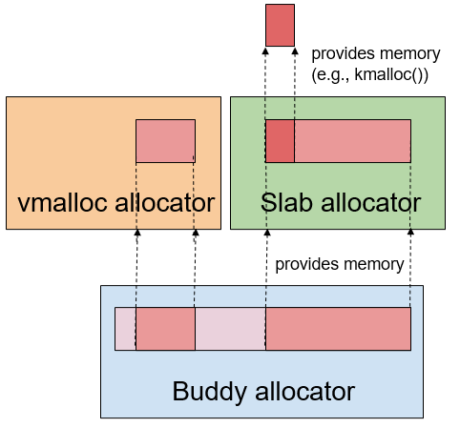
Slabs and Buddies
Extra material
Buddy allocator:
Fast and limits external fragmentation
but considerable internal fragmentation
Often combined with other allocators
E.g., in Linux, the vmalloc and slab allocators sit on top of buddy allocator
So slab allocator gets memory from buddy and parcels this out to callers of kmalloc()
Notes:
Long Description:
The illustration shows a vmalloc allocator in a light yellow colored rectangle, a slab allocator in a green color rectangle, and a buddy allocator in a blue rectangle. A small rectangle of light pink color inside the vmalloc allocator and a small rectangle of light pink color inside the slab allocator corresponds to two sections of a small rectangle inside the buddy allocator. A red rectangle above the slab allocator corresponds to a section inside the light pink rectangle inside the slab allocator. The labeling between the slab allocator and buddy allocator reads provides memory and the labeling between slab allocator and red rectangle reads provides memory start parenthesis e.g., kmalloc parenthesis end parenthesis.

Slide 21
Slab Allocator: Motivation
Extra material
Allocation + freeing of objects of the same type: very common in O S
Speed is of the essence
Unfortunately, allocating, initializing, and destroying objects all take time
E.g., list of free chunks
allocation requires traversing list to
find a chunk of sufficient size
Goal:
make metadata for allocator (e.g., to track what memory is free) very fast
cache as much as possible
Solution:
Slab allocator

Slide 22
Slab Allocator: History
Extra material
Slab caches are an old idea: Jeff Bonwick (Sun Microsystems) 1994
Many incarnations
E.g., Linux:
Adopted S L A B allocators in the 1990s.
Multiple variants available in the kernel: S L O B, S L A B, S L U B
We will look at the general idea

Slide 23
Slab Allocator: Caching makes things simple and fast
Extra material
To allocate an object:
if (there’s an object in the cache) {
take it (no construction required);
} else {
allocate memory;
construct the object;
}
To free an object:
return it to the cache (no destruction required);
To reclaim memory from the cache:
take some objects from the cache;
destroy the objects;
free the underlying memory;

Slide 24
Slab Allocator: Caches for specific objects (or object sizes) (1 of 2)
Extra material
Slab allocator supports mem allocation for kernel.
Kernel needs many different temporary objects:
E.g., dentry, mm_struct, inode, files_struct structures.
Temporary kernel objects
can be both small and large
are often allocated and often freed (efficiency is crucial)
The buddy allocator, which operates with areas composed of entire frames of memory, is not suitable for this.

Slide 25
Slab Allocator: Caches for specific objects (or object sizes) (2 of 2)
Extra material
For instance: a slab cache for inodes or for 16 B objects, etc.
Slab primary unit of currency in slab allocator.
When allocator needs to grow a cache: acquire an entire slab of objects.
When allocator reclaims unused memory: relinquish a complete slab.

Slide 26
Slab Allocator: Reuse and Lookups
Extra material
Goal: efficient memory allocation of objects
Reduces fragmentation
Retains allocated memory containing a data object of a certain type for reuse in later allocations of objects of the same type
By reusing freed objects, under favorable circumstances, you can avoid having to reinitialize them (leaving them partially filled in)
With only objects of the same type in a slab
fast lookup
(simple index)

Slide 27
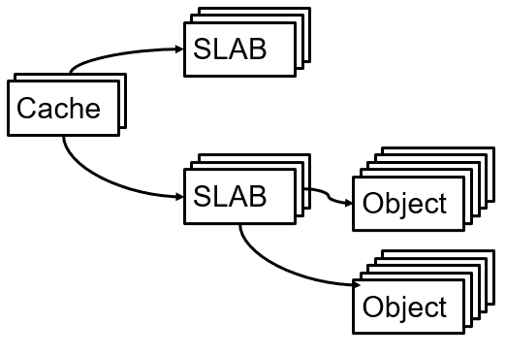
Slab Cache: Organization
Extra material
Each slab cache may contain multiple slabs, each of which contains (or points to) multiple objects
See:
https://www.kernel.org/doc/gorman/html/understand/understand011.html#Sec:%20Tracking%20Free%20Objects

Slide 28
Slab: Example (1)
Extra material
Note 1: Slabs can be implemented in different ways. We will look at one example
Note 2: All slots have the same (known) size, making it easy
to find the
object in the slab
Notes:
Long Description:
The slab is shown by a rectangle divided into 8 slots. The first slot from the left is labeled as slab descriptor. The second slab is again divided into 6 equal sections. The remaining six slots from left to right are labeled as object 0, free slot 1, object 2, object 3, object 4, and free slot 5.

Slide 29
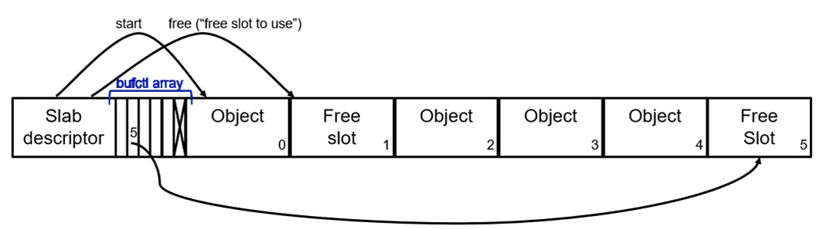
Slab: Example (2)
Extra material
In this example, a Slab contains:
pointer to start of memory with object slots
index of next free slot (“slot for next allocation”)
bufctl: array of indices (“after this free slot has been used for allocation, the next free slot is…”)
Slots for objects
Every entry in bufctl points to next free object (relative to this one). E.g: “the next free slot after this free slot (1) is the slot at index 5 (last slot)” Initially: free =0, bufctl [0] = 1, bufctl [1]= 2, etc.
Allocation: free points to next free object
Deallocation of entry n:
bufctl [n]:= free ;
free := n:
Notes:
Long Description:
The slab is shown by a rectangle divided into 8 slots. The first slot from the left is labeled as slab descriptor. The second slab is again divided into 6 equal sections and labeled as b u f c t l array. The remaining six slots from left to right are labeled as object 0, free slot 1, object 2, object 3, object 4, and free slot 5. An arrow points from slab descriptor to object 0 and is labeled as start. Another arrow points from slab descriptor to free slot 1 and is labeled as free left parenthesis double quotation free slot to use double quotation right parenthesis. An arrow points from b u f c t l array to free slot 5.

Slide 30
Slab: Example (3)
Extra material
For larger objects the memory area can be decoupled from the descriptor
Notes:
Long Description:
The slab is shown by a rectangle divided into 8 slots. The first slot from the left is labeled as slab descriptor. The second slab is again divided into 6 equal sections and labeled as b u f c t l array. The remaining six slots from left to right are labeled as object 0, free slot 1, object 2, object 3, object 4, and free slot 5. An arrow points from slab descriptor to object 0 and is labeled as start. Another arrow points from slab descriptor to free slot 1 and is labeled as free left parenthesis double quotation free slot to use double quotation right parenthesis. An arrow points from b u f c t l array to free slot 5.

Slide 31
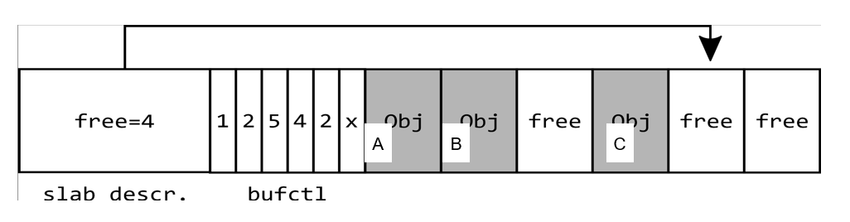
Slab: Example (4)
Extra material
Quiz
Given the initial state of the slab above and the following operations:
D = slab_alloc (obj);
free (B) ;
E = slab_alloc (obj);
F = slab_alloc (obj)
Q: Where is F allocated?
Notes:
Long Description:
The first slot or the slab descriptor is labeled as free equals 4. The b u f c t l array has six slots labeled as 1, 2, 5, 4, 2, and x. The remaining slots of the slab are labeled as follows from left to right. Object A, object b, free, object c, free, and free. A pointer starts from the slab descriptor and points the second last slot.

Slide 32
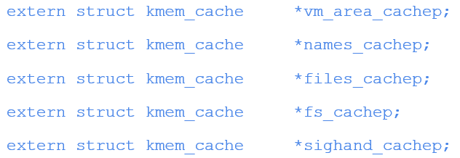
S L A B caches in Linux
Extra material
Dedicated ones and “general” ones.
General: different powers of two
The following dedicated caches exist:
Check /proc/slabinfo for all slab caches
Notes:
Long Description:
The code from top to bottom is as follows.
extern struct k m e m underscore cache asterisk v m underscore area underscore cachep semicolon
extern struct k m e m underscore cache asterisk names underscore cachep semicolon
extern struct k m e m underscore cache asterisk files underscore cachep semicolon
extern struct k m e m underscore cache asterisk f s underscore cachep semicolon
extern struct k m e m underscore cache asterisk sighand underscore cachep semicolon

Slide 33
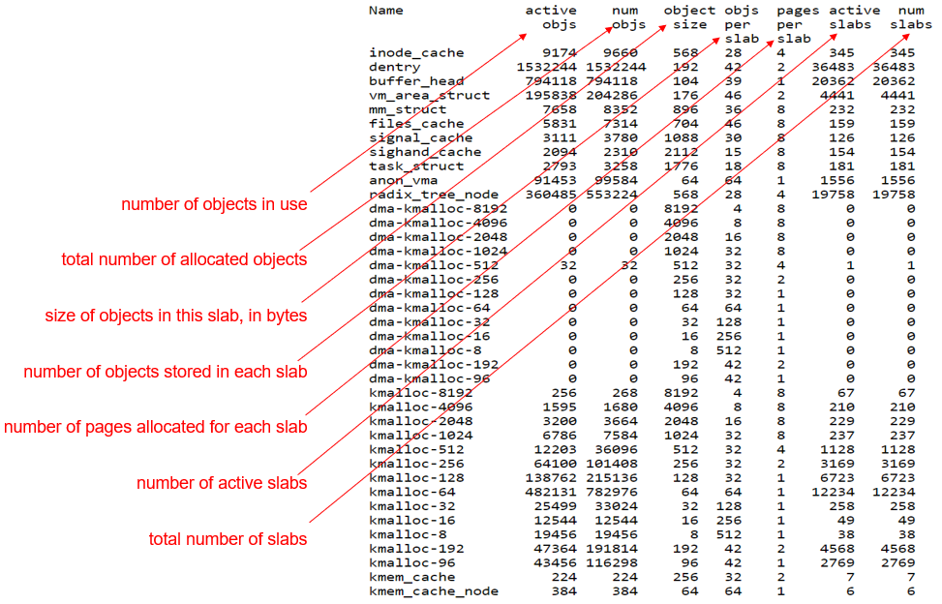
/proc/slabinfo
Notes:
Long Description:
The table has the following column headers: Name; active objs; num objs; objs per slab; pages per slab; active slabs; num slabs; object size; objs per slab; pages per slab; active slabs; num slabs. Pointers to these column headers define them. They read as follows: active objs: number of objects in use; num objs: total number of allocated objects; object size: size of objects in this slab, in bytes; objs pers slab: number of objects stored in each slab; pages per slab: number of pages allocated for each slab; active slabs: number of active slabs; num slabs: total number of slabs.

Slide 34
End of extra material

Slide 35
Virtual Memory (1)
There is a need to run programs that are too large to fit in memory
Solution adopted in the 1960s, split programs into little pieces, called overlays
Kept on the disk, swapped in and out of memory
Initially, only the overlay manager (O M) was loaded
The O M would then load overlay 0 and run it
When done, it would tell the O M to load overlay 1, etc.
Nowadays, we have a better solution: virtual memory
Often implemented using paging

Slide 36
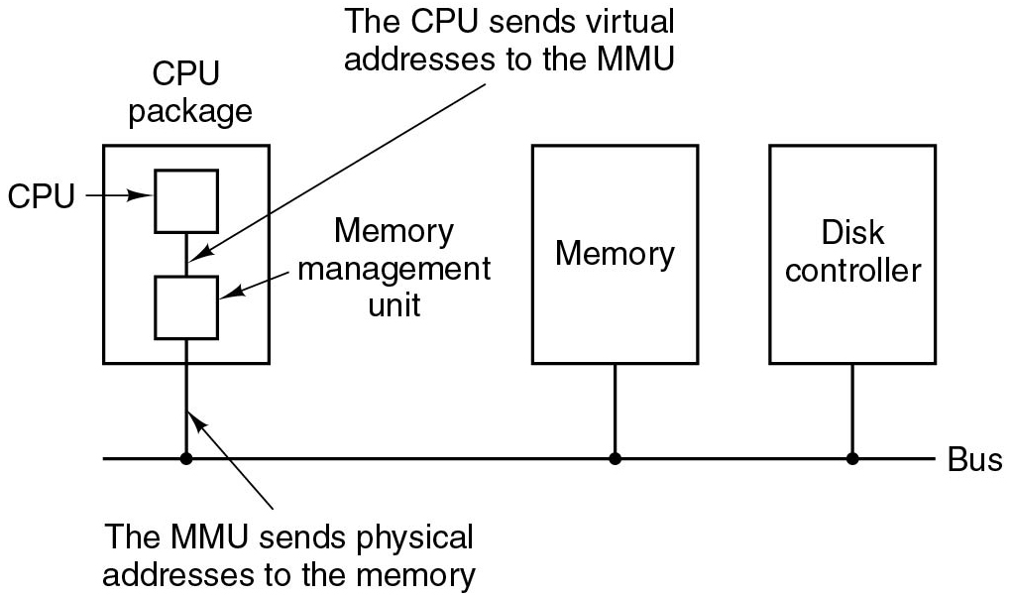
Virtual Memory (2)
Problem: So far memory can only be given to processes in contiguous pieces
Solution:
Create for the process the illusion of a large (e.g., 48 bit) address space
This is known as the virtual address space
The (much more limited) R A M is known as physical memory
Translate virtual addresses (as used by the process) into physical addresses
Typically done in the M M U
Figure 3.8 The position and function of the M M U.
Notes:
Long Description:
The figure consists of a bus onto which three blocks are connected labeled C P U package, memory and disk controller. The C P U package block contains two blocks labeled C P U and Memory management unit and they are connected by a line labeled The C P U sends virtual addresses to the M M U. The blocks are connected to the bus through a line labeled The M M U sends physical addresses to the memory.

Slide 37
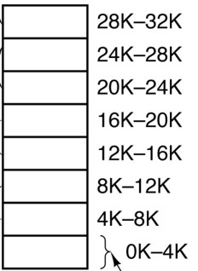
Virtual Memory and Paging
Modern systems use paging:
Divide physical and virtual memory into pages of fixed size (e.g. 4096 bytes)
Translate virtual pages into physical pages (frames)
Notes:
Long Description:
The physical memory space of the eight blank rows from bottom to top are labeled from 0 to 4 k, upto 28 k to 32 k. The blank rows are labeled page frame. The rows of the two blocks are mapped as follows. Row 1 of block one is mapped to row 3 of block two. Row 2 of block one is mapped to row 2 of block two. Row 3 of block one is mapped to row 7 of block two. Row 4 of block one is mapped to row 1 of block two. Row 5 of block one is mapped to row 5 of block two. Row 6 of block one is mapped to row 4 of block two. Row 10 of block one is mapped to row 6 of block two. Row 12 of block one is mapped to row 8 of block two.

Slide 38
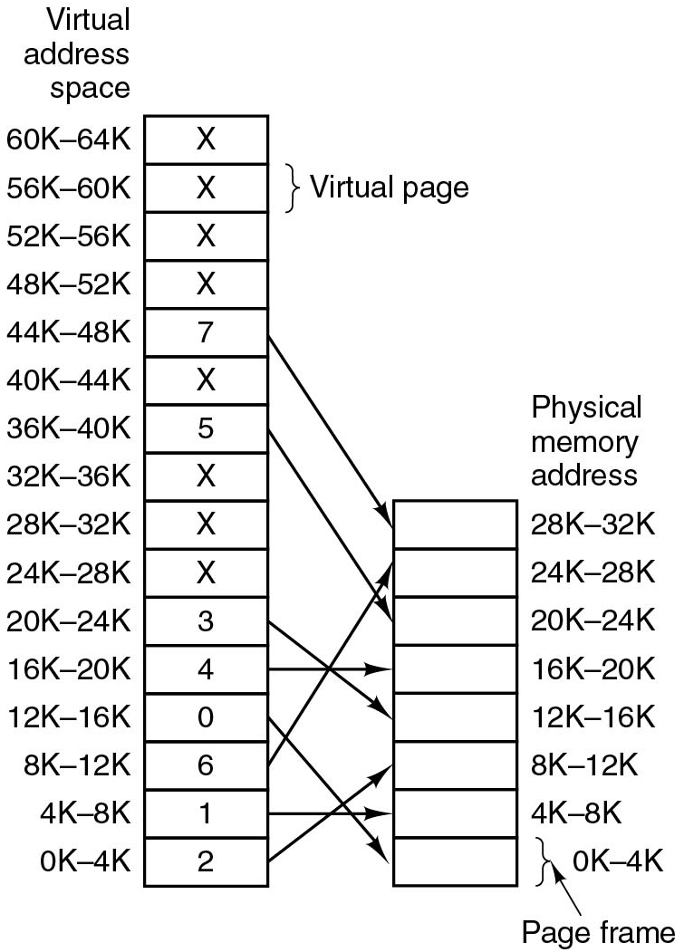
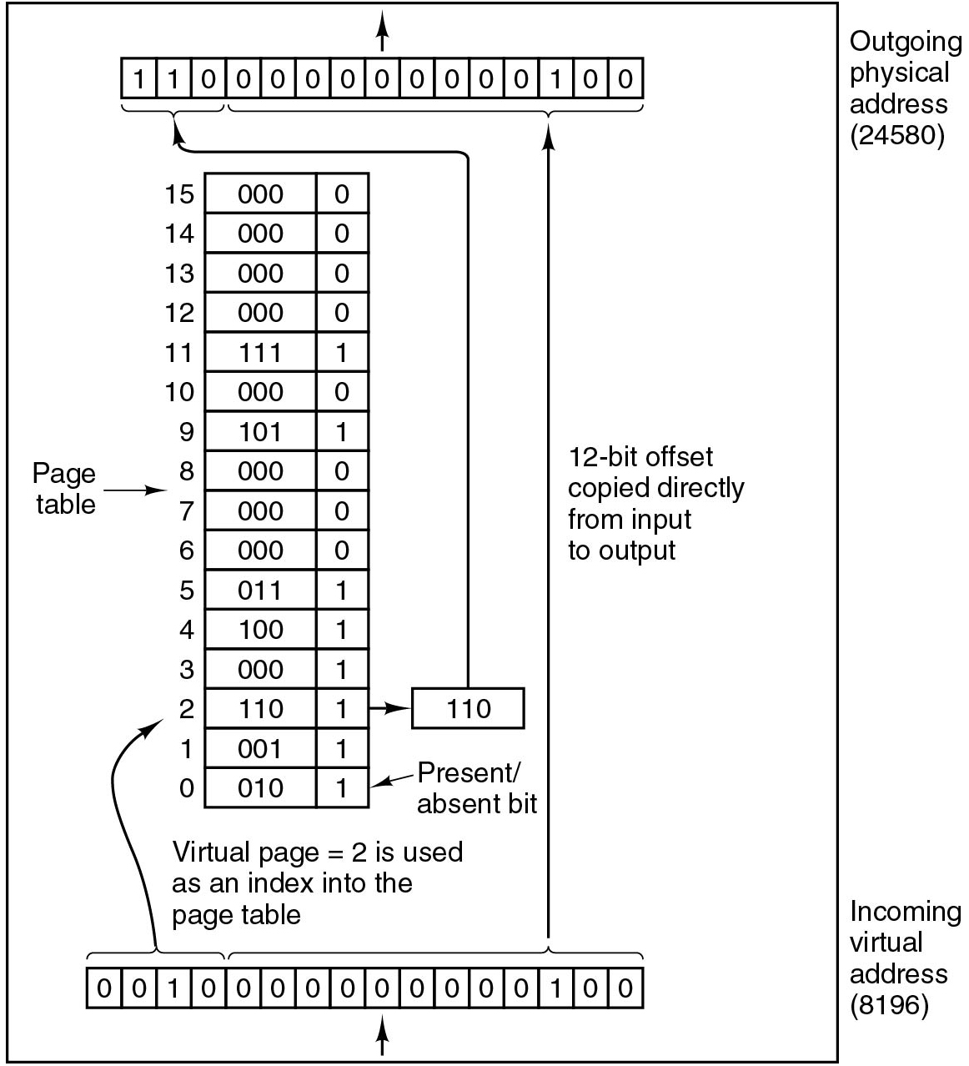
Virtual Address Space versus. Physical Address Space and Page Tables
Figure 3.9 The relation between virtual and physical memory addresses is given by the page table.
Figure 3.10 The internal operation of the M M U with 16 4-K B pages.
Notes:
Long Description1:
The left side shows a rectangle labeled as virtual address space divided into 16 sections. The labelings of the each section on the left side from top to bottom are as follows. 64 K dash 60 K, 56 K dash 60 K, 52 K dash 56 K, 48 K dash 52 K, 44 K dash 48 K, 40 K dash 44 K, 36 K dash 40 K, 32 K dash 36 K, 28 K dash 32 K, 24 K dash 28 K, 20 K dash 24 K, 16 K dash 20 K, 12 K dash 16 K, 8 K dash 12 K, 4 K dash 8 K, and 0 K dash 4 K. The labelings inside each section from top to bottom are as follows. X, X, X, X, 7, X, 5, X, X, X, 3, 4, 0, 6, 1, and 2. A left brace on top is labeled as virtual page. The right side shows a rectangle labeled as physical memory address divided into 8 sections. The labelings of the each section on the right side from top to bottom are as follows. 28 K dash 32 K, 24 K dash 28 K, 20 K dash 24 K, 16 K dash 20 K, 12 K dash 16 K, 8 K dash 12 K, 4 K dash 8 K, and 0 K dash 4 K. A left brace on the bottom is labeled as page frame. An arrow points from 44 K dash 48 K of the left rectangle to 28 K dash 32 K of the right rectangle. Similarly from 36 K dash 40 K to 20 K dash 24 K, from 20 K dash 24 K to 12 K dash 16 K, from 16 K dash 20 K to 16 K dash 20 K, from 12 K dash 16 K to 0 K dash 4 K, from 8 K dash 12 K to 24 K dash 28 K, from 4 K dash 8 K to 4 K dash 8 K, and from 0 K dash 4 K to 8 K dash 12 K.
Long Description2:
The figure shows two horizontal blocks consisting of fifteen and sixteen columns placed at the top and bottom end. In the middle of the figure, a vertical block having two columns and sixteen rows is shown. The columns of the top block are given as follows. 1, 1, 0, 0, 0, 0, 0, 0, 0, 0, 0, 0, 1, 0, 0. An arrow is pointed upward from the block and labeled outgoing physical address (24580). The columns of the bottom block are labeled as follows: 0, 0, 1, 0, 0, 0, 0, 0, 0, 0, 0, 0, 0, 1, 0, 0. An arrow is pointed upward toward the block from bottom and labeled incoming physical address (8196). An arrow labeled 12-bit offset copied directly from input to output is pointed from the last 12 columns of the bottom block to the last 12 columns of the top block.
The page table of the vertical block ranges from 0 to 15 in increments of 1 unit. The row entries of the block from bottom to top are given as follows.
Row 0: Column one, 010. column two, 1.
Row 1: Column one, 001. column two, 1.
Row 2: Column one, 110. column two, 1.
Row 3: Column one, 000. column two, 1.
Row 4: Column one, 100. column two, 1.
Row 5: Column one, 011. column two, 1.
Row 6: Column one, 000. column two, 0.
Row 7: Column one, 000. column two, 0.
Row 8: Column one, 000. column two, 0.
Row 9: Column one, 101. column two, 1.
Row 10: Column one, 000. column two, 0.
Row 11: Column one, 111. column two, 1.
Row 12: Column one, 000. column two, 0.
Row 13: Column one, 000. column two, 0.
Row 14: Column one, 000. column two, 0.
Row 15: Column one, 000. column two, 0.
Column 2 of this block is labeled present or absent bit.
An arrow points from the first four columns of the bottom block to the row two of the vertical block and labeled virtual page equals 2 is used as an index into the page table. Another arrow points from the row two of the vertical block to a block labeled 110 which is again pointed to the first three columns of the top block.

Slide 39
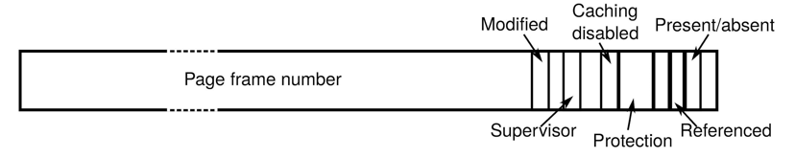
Structure of a Page Table Entry
Questions:
How big is the page table?
How many page tables?
Figure 3.11 A typical page table entry.
4K B page size (typical)
32 bit systems:
32 bit address space and 32 page table entries (P T E s)
64 bit systems
really: 48-bit or 57-bit address space (!) and 64-bit P T E s
Notes:
32b: explain that there is no separate X flag, just R
Also: explain the meaning of the flags in P G D, P M D, etc. Refer to: https://wiki.osdev.org/Paging (excellent)
Long Description:
The block is divided into a large segment labeled page frame number and ten small segments labeled modified, blank, super visor, blank, catching disabled, protection, blank, referenced, present or absent and blank.

Slide 40
Page Table Sizes
A very large virtual address space would lead to a very large
page table
not nice!
Possible solutions:
Multi-level page tables
Inverted page tables

Slide 41
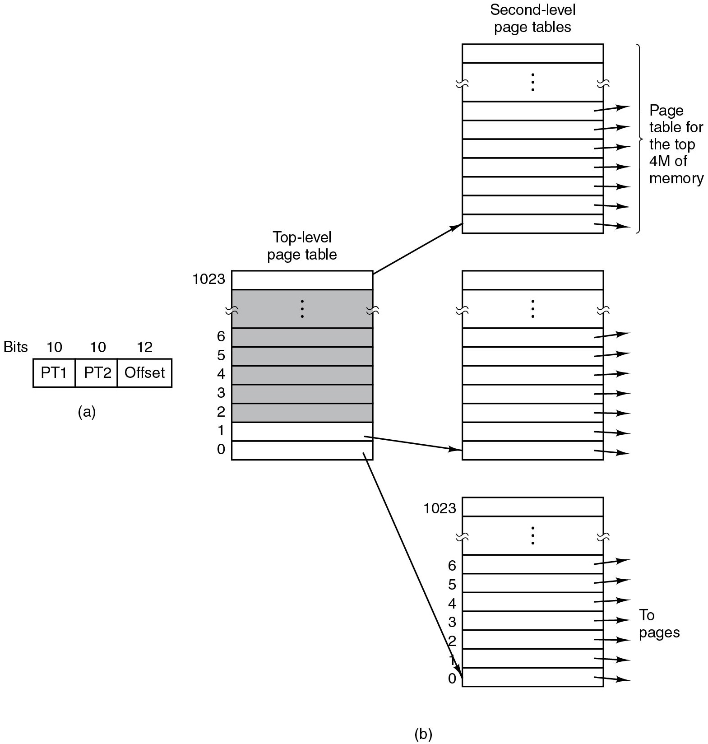
Two-level Page Tables (x86)
Page tables are “walked” by hardware M M U = Memory Management Unit
C R 3 register (special register to point to top of page table hierarchy)
Figure 3.13 (a) A 32-bit address with two page table fields. (b) Two-level page tables.
Notes:
32b: explain that there is no separate X flag, just R
Also: explain the meaning of the flags in P G D, P M D, etc. Refer to: https://wiki.osdev.org/Paging (excellent)
Long Description:
Part (a): A block consists of three rows. The rows are labeled P T 1, P T 2 and offset. The bits of the segments are given as 10, 10, 12.
Part (b): A block labeled top level page table has 1023 rows labeled from bottom to top as follows. 0, 1, 2, 3, 4, 5, 6, upto 1023. All the rows except the first, second and last are shaded.
This block is pointed to three other blocks labeled second level page tables which are placed one below the other. The blocks also consist of 1023 rows. Arrows are pointed from all the rows of these blocks. From the top block, the arrows are pointed to the Page table for the top 4 M of memory and from the top block, the arrows are pointed to the pages.

Slide 42
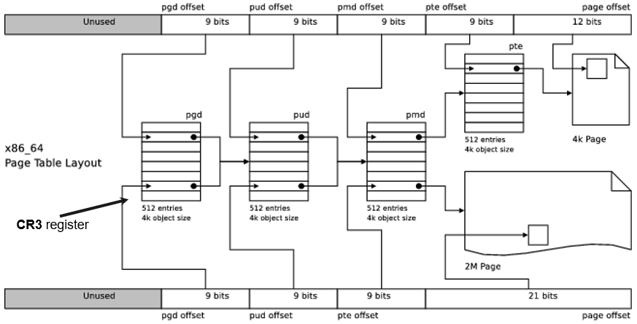
Four-level Page Tables (x86-64)
P G D: Page Global Directory, P U D: Page Upper Directory P M D: Page Mid-level Directory, P T E: page table entry
Notes:
Long Description:
The illustration shows a rectangle on top divided into 6 sections labeled from left to right as unused, p g d offset 9 bits, p u d offset 9 bits, p m d offset 9 bits, p t e offset 9 bits, and page offset 12 bits. The rectangle at the bottom is divided into 5 sections labeled from left to right as unused, p g d offset 9 bits, p u d offset 9 bits, p t e offset 9 bits, and page offset 21 bits. The p g d offset 9 bits of both rectangles points toward the p g d table in the middle. The labeling at the bottom of the p g d table reads 512 entries 4 k object size. The p u d offset 9 bits of both rectangles points toward the p g d table in the middle. The labeling at the bottom of the p u d table reads 512 entries 4 k object size. The p m d offset 9 bits of top section and p t e offset 9 bits of bottom section point toward the p g d table in the middle. The labeling at the bottom of the p m d table reads 512 entries 4 k object size. The p t e offset 9 bits of the top section points toward a p t e table in the middle. The labeling at the bottom of the p t e table reads 512 entries 4 k object size. The page offset 12 bits of the top section points toward a 4 k page in the middle while the page offset 21 bits of the bottom section points towards a 2 M page. All the tables and pages in the middle of the illustration are linked with each other. An arrow labeled as C R 3 register points toward the p g d table.

Slide 43
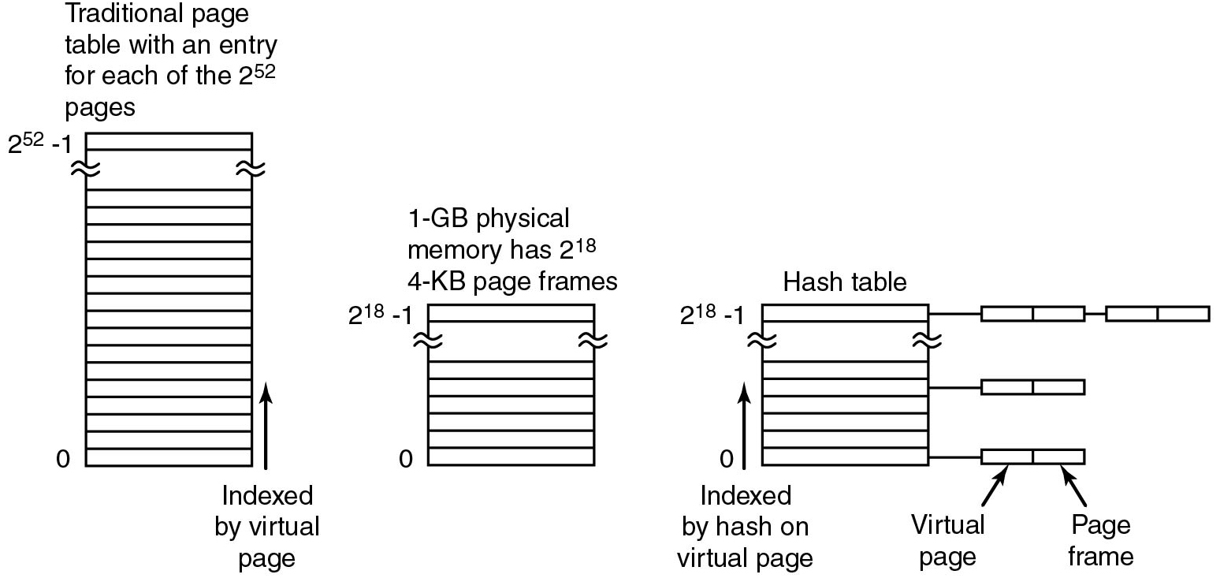
Inverted Page Tables (I A-64)
Figure 3.14 Comparison of a traditional page table with an inverted page table.
Notes:
Long Description:
The figure consists of three vertical blocks. The first block labeled traditional page table with an entry for each of the 2 raised to the 52 power pages consists of 2 raised to 52 power rows. An arrow labeled indexed by virtual page is pointed upward from bottom.
The second block labeled 1-G B physical memory has 2 raised to the eighteenth power. 4-K B page frames consist of 2 raised to the eighteenth power rows.
The third block labeled hash table consists of 2 raised to the eighteenth power rows. The top row is connected to two blocks containing two segments and connected sequentially. The first and fifth rows are also connected to blocks containing two segments. The first segment is labeled virtual page and the second segment is labeled page frame.

Slide 44
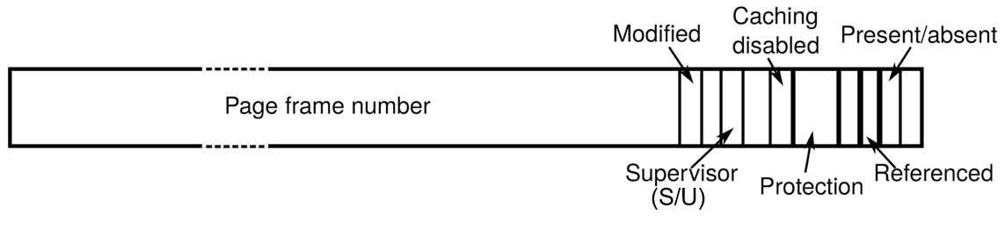
Going Back to P T E s in a Minute Ellipsis
Extra material
We have these at each level
What happens if we combine them?
Notes:
Long Description:
The illustration is a rectangle with slots labeled from left to right as follows. The first slot is labeled as page frame number. Other labellings with a gap of one slot are as follows. Modified, supervisor, and caching disabled. The following slot is labeled as protection. After a gap of one slot, the slots labeled are as follows. Referenced and present slash absent. This is followed by an unlabeled slot. All the labelings are pointed out by pointers. A long pointer pointing supervisor is labeled as follows. Additional flag: global implies don't flush.

Slide 45
What happens if
Extra material
P D entry says:
P T entry says:
P D entry says:
P T entry says:
P D entry says:
P T entry says:
P D entry says:
P T entry says:
simply means supervisor flag (which can be Supervisor or User)

Slide 46
Combining Protection of Both Levels of Page Tables
Extra material
From the
Intel® 64 and I A-32 Architectures Software Developer’s Manual Volume 3A:
For any one page, the protection attributes of its page-directory entry (first-level page table) may differ from those of its page-table entry (second-level page table). The processor checks the protection for a page in both its page-directory and the page-table entries. Table 4-3 shows the protection provided by the possible combinations of protection attributes when the W P flag is clear.

Slide 47
Perhaps surprising?
Extra material
Note: C R0 is a special control register in x86
In principle: protection = strictest subset
However, if C R0.W P=0, supervisor always has R W access
Notes:
Table taken from: Intel® 64 and IA-32 Architectures Software Developer’s Manual Volume 3A: https://www.intel.com/content/dam/support/us/en/documents/processors/pentium4/sb/25366821.pdf
Long Description:
The table has 3 columns and 16 rows. The column headings are as follows from left to right. Page-directory entry privilege, page-directory entry access type, page-table entry privilege, page-table entry access type, combined effect privilege, and combined effect access type. The row entries are as follows from left to right. Row 1: Page-directory entry privilege, user; page-directory entry access type, read-only; page-table entry privilege, user; page-table entry access type, read-only; combined effect privilege, user; and combined effect access type, read-only. Row 2: Page-directory entry privilege, user; page-directory entry access type, read-only; page-table entry privilege, user; page-table entry access type, read-write; combined effect privilege, user; and combined effect access type, read-only. Row 3: Page-directory entry privilege, user; page-directory entry access type, read-write; page-table entry privilege, user; page-table entry access type, read-only; combined effect privilege, user; and combined effect access type, read-only. Row 4: Page-directory entry privilege, user; page-directory entry access type, read-write; page-table entry privilege, user; page-table entry access type, read-write; combined effect privilege, user; and combined effect access type, read slash write. Row 5: Page-directory entry privilege, user; page-directory entry access type, read-only; page-table entry privilege, supervisor; page-table entry access type, read-only; combined effect privilege, supervisor; and combined effect access type, read slash write asterisk exclamation mark. Row 6: Page-directory entry privilege, user; page-directory entry access type, read-only; page-table entry privilege, supervisor; page-table entry access type, read-write; combined effect privilege, supervisor; and combined effect access type, read slash write asterisk exclamation mark. Row 7: Page-directory entry privilege, user; page-directory entry access type, read-write; page-table entry privilege, supervisor; page-table entry access type, read-only; combined effect privilege, supervisor; and combined effect access type, read slash write asterisk. Row 8: Page-directory entry privilege, user; page-directory entry access type, read-write; page-table entry privilege, supervisor; page-table entry access type, read-write; combined effect privilege, supervisor; and combined effect access type, read slash write. Row 9: Page-directory entry privilege, supervisor; page-directory entry access type, read-only; page-table entry privilege, user; page-table entry access type, read-only; combined effect privilege, supervisor; and combined effect access type, read slash write asterisk exclamation mark. Row 10: Page-directory entry privilege, supervisor; page-directory entry access type, read-only; page-table entry privilege, user; page-table entry access type, read-write; combined effect privilege, supervisor; and combined effect access type, read slash write asterisk exclamation mark. Row 11: Page-directory entry privilege, supervisor; page-directory entry access type, read-write; page-table entry privilege, user; page-table entry access type, read-only; combined effect privilege, supervisor; and combined effect access type, read slash write asterisk exclamation mark. Row 12: Page-directory entry privilege, supervisor; page-directory entry access type, read-write; page-table entry privilege, user; page-table entry access type, read-write; combined effect privilege, supervisor; and combined effect access type, read slash write. Row 13: Page-directory entry privilege, supervisor; page-directory entry access type, read-only; page-table entry privilege, user; page-table entry access type, read-only; combined effect privilege, supervisor; and combined effect access type, read slash write asterisk exclamation mark. Row 14: Page-directory entry privilege, supervisor; page-directory entry access type, read-only; page-table entry privilege, user; page-table entry access type, read-write; combined effect privilege, supervisor; and combined effect access type, read slash write asterisk exclamation mark. Row 15: Page-directory entry privilege, supervisor; page-directory entry access type, read-write; page-table entry privilege, user; page-table entry access type, read-only; combined effect privilege, supervisor; and combined effect access type, read slash write asterisk exclamation mark. Row 16: Page-directory entry privilege, supervisor; page-directory entry access type, read-write; page-table entry privilege, user; page-table entry access type, read-only; combined effect privilege, supervisor; and combined effect access type, read slash write.

Slide 48
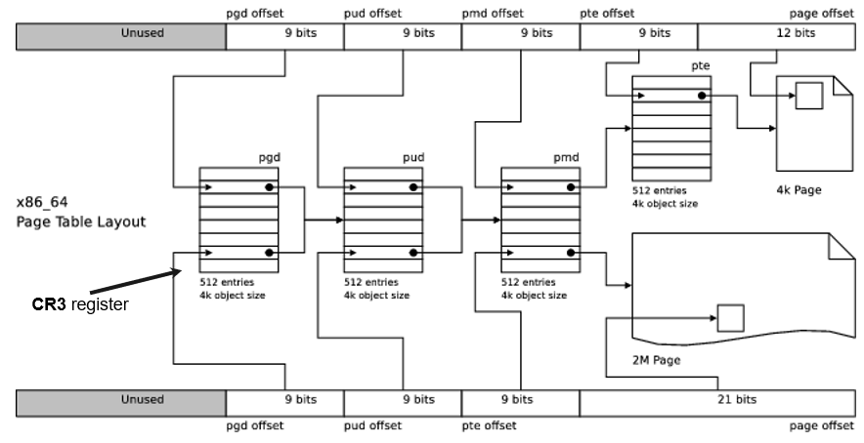
Four-Level Page Tables: Lots of Memory Accesses!
P G D: Page Global Directory, P U D: Page Upper Directory, P M D: Page Mid-level Directory, P T E: page table entry
Notes:
Long Description:
The illustration shows a rectangle on top divided into 6 sections labeled from left to right as unused, p g d offset 9 bits, p u d offset 9 bits, p m d offset 9 bits, p t e offset 9 bits, and page offset 12 bits. The rectangle at the bottom is divided into 5 sections labeled from left to right as unused, p g d offset 9 bits, p u d offset 9 bits, p t e offset 9 bits, and page offset 21 bits. The p g d offset 9 bits of both rectangles points toward the p g d table in the middle. The labeling at the bottom of the p g d table reads 512 entries 4 k object size. The p u d offset 9 bits of both rectangles points toward the p g d table in the middle. The labeling at the bottom of the p u d table reads 512 entries 4 k object size. The p m d offset 9 bits of top section and p t e offset 9 bits of bottom section point toward the p g d table in the middle. The labeling at the bottom of the p m d table reads 512 entries 4 k object size. The p t e offset 9 bits of the top section points toward a p t e table in the middle. The labeling at the bottom of the p t e table reads 512 entries 4 k object size. The page offset 12 bits of the top section points toward a 4 k page in the middle while the page offset 21 bits of the bottom section points towards a 2 M page. All the tables and pages in the middle of the illustration are linked with each other. An arrow labeled as C R 3 register points toward the p g d table.

Slide 49
Translation Lookaside Buffer (1)
Problem: M M U has to translate every single memory access
Performance problem
Solution: Cache previous translations, hoping programs
A high degree of locality.
Valid | Virtual Page | Modified | Protection | Page Frame
1 | 140 | 1 | RW | 31
1 | 20 | 0 | R X | 38
1 | 130 | 1 | RW | 29
1 | 129 | 1 | RW | 62
1 | 19 | 0 | R X | 50
1 | 21 | 0 | R X | 45
1 | 860 | 1 | RW | 14
1 | 861 | 1 | RW | 75
Figure 3.12 A T L B to speed up page.

Slide 50
Translation Lookaside Buffer (2)
Extra material
Questions:
How many T L B s?
When to flush T L B?
When to expect many T L B misses?

Slide 51
Translation Lookaside Buffer (3)
Extra material
Questions:
How many T L B s?
When to flush T L B?
When to expect many T L B misses?
Super expensive memory: small number of entries (e.g., 64-128)
Sometimes separate entries for huge (2 M B) pages and normal (4 K B) pages
Often separate T L B s for code and data
1 per C P U, but sometimes multiple levels of T L B (L 1 T L B versus L 2 T L B)

Slide 52
Translation Lookaside Buffer (4)
Extra material
Questions:
How many T L B s?
When to flush T L B?
When to expect many T L B misses?
When entries change
Traditionally: at context switch
Improvement: tag T L B entries with id of process (no need to flush if no other process uses your id)

Slide 53
Translation Lookaside Buffer (5)
Extra material
Questions:
How many T L B s?
When to flush T L B?
When to expect many T L B misses?
After flushes
When the program exhibits little locality

Slide 54
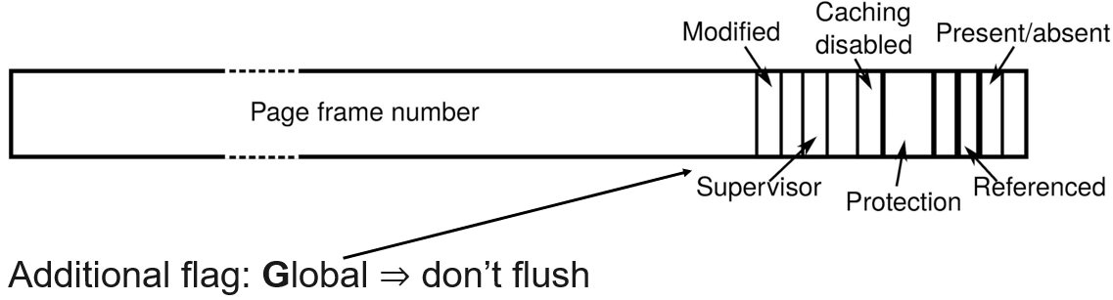
Translation Lookaside Buffer (6)
Extra material
B T W when not to flush?
Notes:
Long Description:
The illustration is a rectangle with slots labeled from left to right as follows. The first slot is labeled as page frame number. Other labellings with a gap of one slot are as follows. Modified, supervisor, and caching disabled. The following slot is labeled as protection. After a gap of one slot, the slots labeled are as follows. Referenced and present slash absent. This is followed by an unlabeled slot. All the labelings are pointed out by pointers. A long pointer pointing supervisor is labeled as follows. Additional flag: global implies don't flush.

Slide 55
T L B Misses and Page Fault Handling (1)
Software- versus. hardware-managed T L B:
T L B misses handled by O S versus. hardware
Flexibility versus. Efficiency
Hardware walks P T s and fills T L B
E.g., O S may preload T L B entries that it expects to need later (say the entries for a server to which current process sends msg)

Slide 56
T L B Misses and Page Fault Handling (2)
T L B miss handling:
Walk page tables to find the mapping
If mapping found, fill new T L B entry (soft miss)
If mapping not found, page fault (hard miss)
O S handles P F s (similar to interrupts), cases:
Access violation (segmentation fault)
Legal access, P F handler needs to fix up page tables:
The page is already in memory (minor P F) O R
The page must be fetched from disk (major P F)

Slide 57
Page Replacement
Computer might use more virtual memory than it has physical memory
Paging creates the illusion of unlimited memory available to user processes
When a logical page is not in memory (swapped out to a file/partition), the O S has to page it in on a page fault
Swapping out: direct or indirect reclaim
Another logical page has to be swapped out
which?

Slide 58
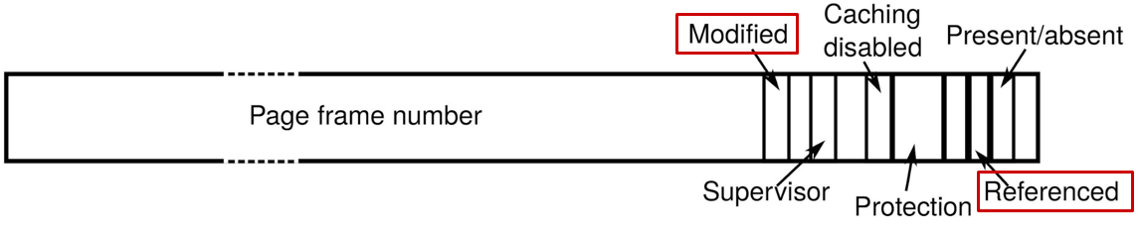
Page Replacement: Hardware Support
Extra material
Relevant P T E bits, e.g.:
Modified (M): Set when page modified (aka “dirty” bit)
Referenced (R): Set when page accessed (aka “accessed” bit)
Available: Reserved for S W extensions
e.g., Soft-dirty bit on Linux, set by the kernel at every write page
fault (P F)
because “dirty” bit is also used for other internal
purposes
Notes:
soft dirty bit mark pages R O → page fault: set soft dirty bit
Long Description:
The illustration is a rectangle with slots labeled from left to right as follows. The first slot is labeled as page frame number. Other labellings with a gap of one slot are as follows. Modified in a red rectangle, supervisor, and caching disabled. The following slot is labeled as protection. After a gap of one slot, the slots labeled are as follows. Referenced in a red rectangle and present slash absent. This is followed by an unlabeled slot. All the labelings are pointed out by pointers.

Slide 59
Page Replacement Algorithms
Optimal algorithm
Not recently used algorithm
First-in, first-out (F I F O) algorithm
Second-chance algorithm
Clock algorithm
Least recently used (L R U) algorithm
Working set algorithm
W S Clock algorithm

Slide 60
Page Replacement: Basic Algorithms
Optimal:
Replace page that will be referenced as far in the future as possible
Can this algorithm be implemented in practice?
Random:
Simply replace a page at random
Not Recently Used (N R U):
Classes of pages:
Class 0: R=0, M=0, Class 1: R=0, M=1, Class 2: R=1, M=0, Class 3: R=1, M=1
Periodically clear R/M bit for all the pages.
Replace a page at random, but prioritize class 0, then class 1, etc.
F I F O:
Build queue of faulting pages and replace the head
However, oldest page may still be useful

Slide 61
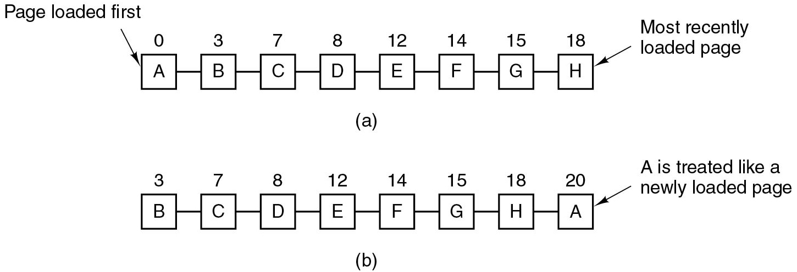
Page Replacement: Second Chance
Figure 3.15 Operation of second chance. (a) Pages sorted in F I F O order. (b) Page list if a page fault occurs at time 20 and A has its R bit set. The numbers above the pages are their load times.
Improved F I F O to preserve important pages
For each visited page:
If R = 0 then replace page
If R = 1 then set R = 0 and move page to tail
Notes:
Long Description:
Part (a): A set of eight square blocks are connected sequentially. The blocks are labeled A, B, C, D, E, F, G, H from left to right. The A block represents the page loaded first and the H block represents the most recently loaded page. The blocks are numbered as 0, 3, 7, 8, 12, 14, 15, and 18 from left to right.
The blocks of part b are labeled B, C, D, E, F, G, H, A from left to right. The A block is labeled A is treated like a newly loaded page. The blocks are numbered as 3, 7, 8, 12, 14, 15, 18, 20 from left to right.

Slide 62
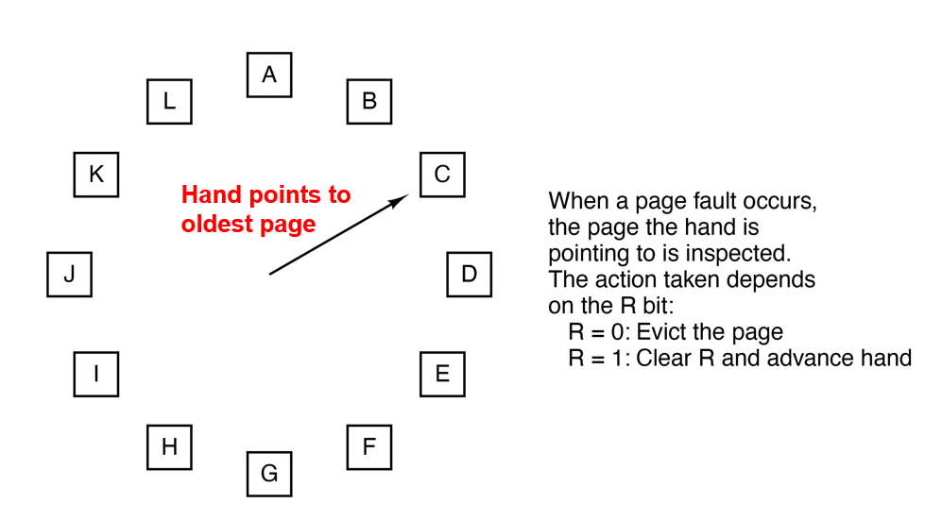
Page Replacement: CLOCK
Figure 3.16 The clock page replacement algorithm.
Notes:
Explain: second chance algorithm: good, but needlessly inefficient due to constant list manipulations. CLOCK has 1 circular list.
Long Description:
The figure shows a circle of twelve square blocks labeled A, B, C, D, E, F, G, H, I, J, K, and L starting from the top in clockwise direction. An arrow from the center points to the block C.
Note: When a page fault occurs, the page the hand is pointing to is inspected. The action taken depends on the R bit: R equals 0: Evict the page. R equals 1: Clear R and advance hand.

Slide 63
Page Replacement: Least Recently Used (L R U)
Idea: Replace page that has been unused for the longest
Good predictor for optimal in many (but not all) cases
Can L R U ever perform worse than random?
H W-assisted solutions:
Maintain an ordered page list at each reference
Head is L R U page
Maintain reference timestamps in P T E s
Oldest-timestamp P T E points to L R U page
Rarely implemented in practice
Notes:
LRU worse than random: 4 pages, access pattern: 12345 12345 …
HW assisted solutions:
have hw maintain ordered page list at each reference with LRU page at head ⇒ super expensive
timestamps in PTEs at every reference ⇒ also very expensive

Slide 64
Page Replacement: L R U-like Strategies
Not Frequently Used (N F U):
Maintain per-page counters and periodically add (and clear) the R bit to every counter
Replace the page with the lowest counter
Problem: N F U never “forgets” pages
Aging:
Improve N F U by:
Add R bit to the leftmost bit
Shifting counters to the right
Offers lower temporal resolution than “real” L R U
CLOCK (and variations) more often used in practice
Notes:
LRU worse than random: 4 pages, access pattern: 12345 12345 …
HW assisted solutions:
have hw maintain ordered page list at each reference with LRU page at head ⇒ super expensive
timestamps in PTEs at every reference ⇒ also very expensive

Slide 65
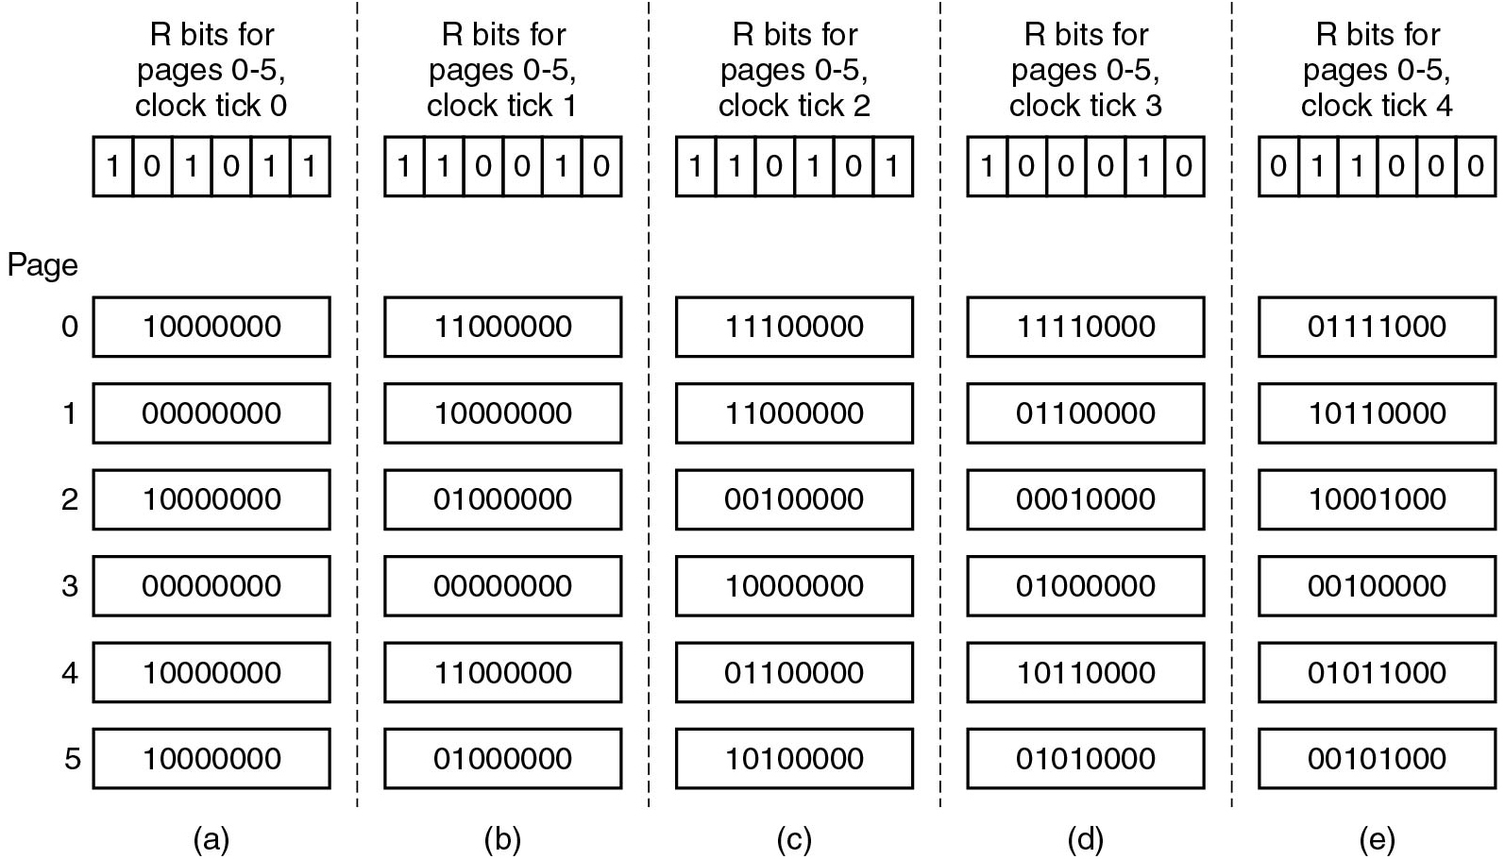
Simulating L R U in Software
Figure 3.17 The aging algorithm simulates L R U in software. Shown are six pages for five clock ticks. The five clock ticks are represented by (a) to (e).
Notes:
Long Description:
The clock ticks are shown by five sets of seven blocks placed from top to bottom and each set separated by a dashed line. The top most block in each set consists of six columns. The page numbers are numbered 0 to 5 from top to bottom.
Part (a): The columns of the topmost block labeled R bits for pages 0-5, clock tick 0 are marked 1, 0, 1, 0, 1, 1.
The remaining six blocks for pages 0 to 6 are labeled as follows: 10000000, 00000000, 10000000, 00000000, 10000000, 10000000.
Part (b): The columns of the topmost block labeled R bits for pages 0-5, clock tick 1 are marked 1, 1, 0, 0, 1, 0.
The remaining six blocks for pages 0 to 6 are labeled as follows: 11000000, 10000000, 01000000, 00000000, 11000000, 01000000.
Part (c): The columns of the topmost block labeled R bits for pages 0-5, clock tick 2 are marked 1, 1, 0, 1, 0, 1.
The remaining six blocks for pages 0 to 6 are labeled as follows: 11100000, 11000000, 00100000, 10000000,
01100000, 10100000.
Part (d): The columns of the topmost block labeled R bits for pages 0-5, clock tick 3 are marked 1, 0, 0, 0, 1, 0.
The remaining six blocks for pages 0 to 6 are labeled as follows: 11110000, 01100000, 00010000, 01000000,
10110000, 01010000.
Part (e): The columns of the topmost block labeled R bits for pages 0-5, clock tick 3 are marked 0, 1, 1, 0, 0, 0.
The remaining six blocks for pages 0 to 6 are labeled as follows: 01111000, 10110000, 10001000, 00100000, 01011000, 00101000.

Slide 66
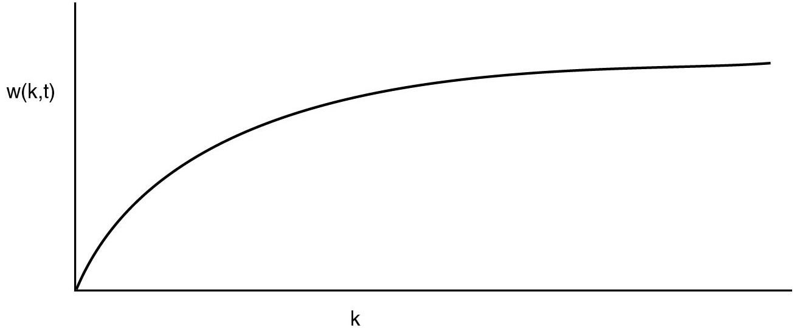
Page Replacement: W S and W S Clock
Working Set: set of pages that a process is currently using
Figure 3.18 The working set is the set of pages used by the k most recent memory references. The function w(k, t) is the size of the working set at time t.
Notes:
Long Description:
The horizontal axis is labeled k and the vertical axis is labeled w (k, t). The curve starts at the origin, rises toward upper right , moves like a parabola and ends at the upper right end, parallel to the horizontal axis of the first quadrant.

Slide 67
Working Set
If (W S in memory) {few page faults} else {many page faults}
If (memory too small for W S) {thrashing}
Most programs exhibit locality of reference
Maybe ensure pages in W S not replaced?
Maybe ensure W S is in memory by prepaging?

Slide 68
Working Set Algorithm (1)
W S = all pages referenced last τ seconds of virtual time (time consumed by process)
Note that τ spans multiple clock ticks

Slide 69
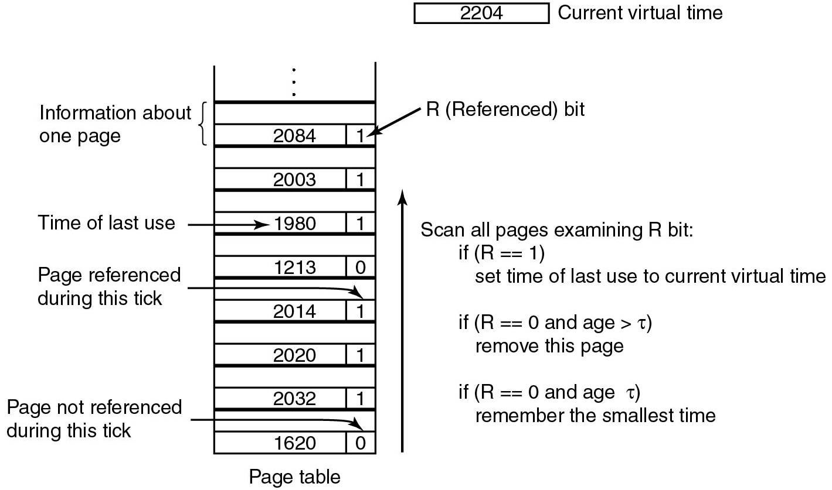
Working Set Algorithm (2)
NOTE: at periodic clock interrupt we clear R
Figure 3.19 The working set algorithm.
Notes:
periodically (every clock tick): clear R bit
On P F : scan all R bits → if 1 → time of last use = current virtual time → not replaced
if R is 0 → it is still in the W S if age > current time - tau
Long Description:
A vertical block is labeled page table and it consists of n number of rows having alternate blank rows from bottom to top. The first segments of the alternate filled rows consisting of two segments are labeled from bottom to top are as follows: 1620, 2032, 2020, 2014, 1213, 1990 which represents time of last use, 2003, 2094. The second segments are labeled 0 which represents Page not referenced during this tick, 1, 1, 1 which represents Page referenced during this tick, 0, 1, 1, 1 which represents R called reference bit. The fifteenth and sixteenth row represents information about one page. Another block labeled 2204 is placed at the upper right end which represents the current virtual time.
A program is also shown near the block as follows.
Scan all pages examining R bit:
If (R equals equals 1) set time of last use to current virtual time. If (R equals equals 0 and age greater than tau) remove this page. If (R equals equals 0 and age less than or equals tau) remember the smallest time.

Slide 70
W S Clock (1)
Previous model is cumbersome as we must scan the page tables for each P F
W S Clock combines Clock and W S and is more efficient

Slide 71
W S Clock (2)
Previous model is cumbersome as we must scan the page tables for each P F
W S C lock combines Clock and W S and is more efficient
Circular list of page frames (initially empty)
When page referenced
add to list with time
Advance hand + check
(else
skip after updating time)
If
simply replace
If
schedule write and cont.
If hand comes all the way around
2 cases:
At least one page scheduled for write
No page scheduled for write
any clean page (if available)
otherwise current page``

Slide 72
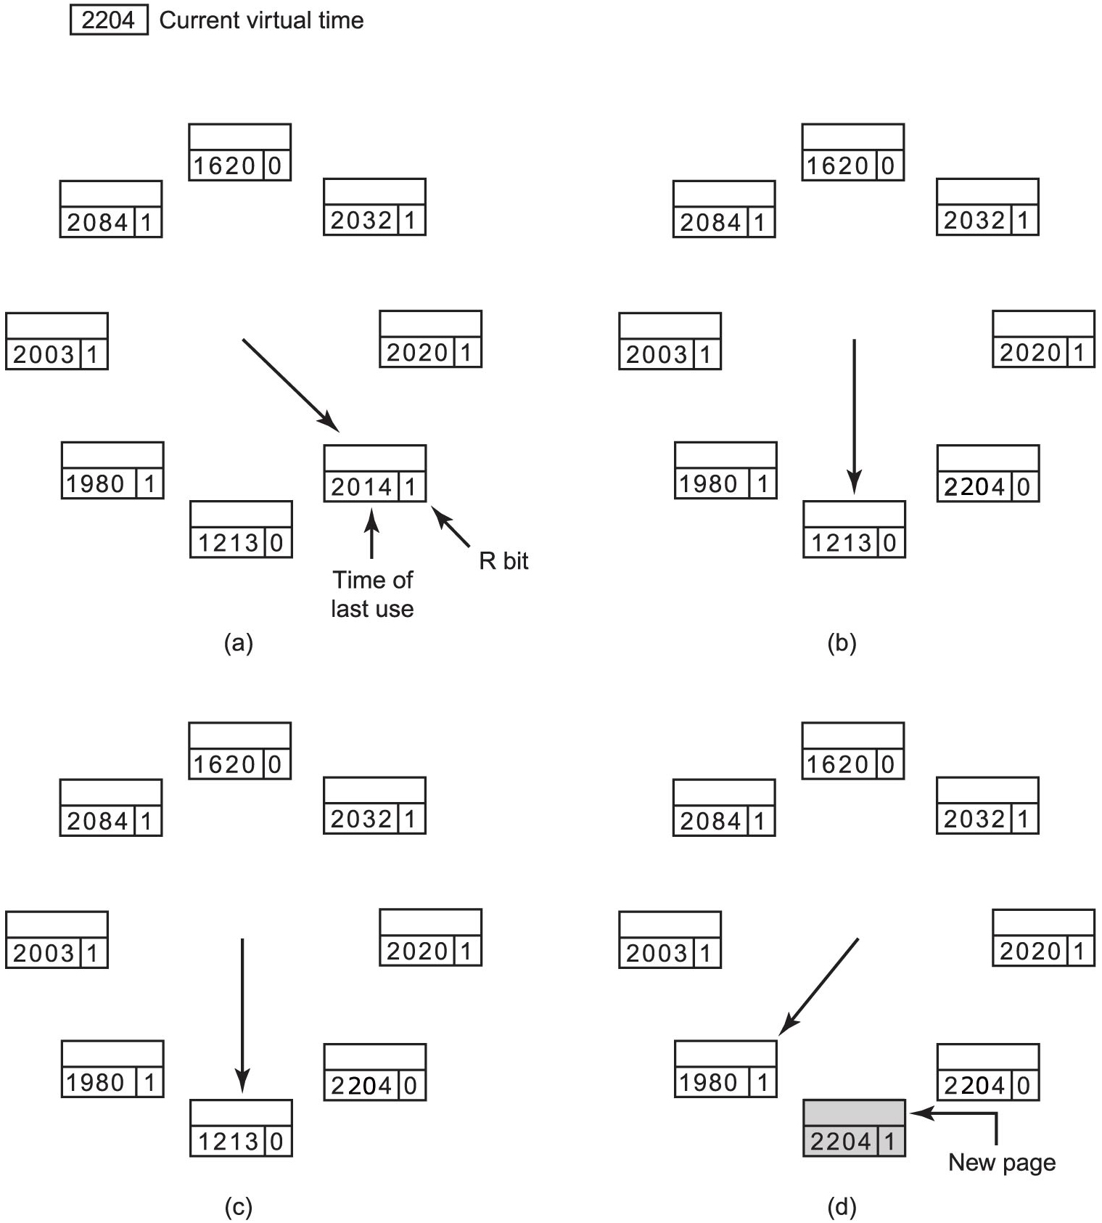
W S Clock Algorithm (1)
Figure 3.20 Operation of the W S Clock algorithm. (a) and (b) give an example of what happens when R = 1.
Notes:
A W S Clock algorithm with the current virtual time as 2204. A, the W S clock has 8 entries. Each entry contains the time of last use along with a R bit value. The entries in the clockwise direction are as follows. 1620, 0. 2032, 1. 2020, 1. 2204, 1. 1213, 0. 1980, 1. 2003, 1. 2084, 1. The hand in the clock points to the entry 2014, 1. In B, the hand points to the entry 1213, 0.
Long Description:
The left illustration is labeled as a in parenthesis. It has 8 rectangles placed in a round shape divided into three sections. The labelings of the two bottom sections of the rectangles in a clockwise direction are as follows. 1620, 0; 2032, 1; 2020, 1; 2014, 1; 1213, 0; 1980, 1; 2003, 1; and 2084, 1. An arrow points toward the empty section of the fourth rectangle from the center, another arrow labeled as time of last use toward the second section labeled 2014, and another arrow labeled as R bit toward the third section labeled 1. The right illustration is labeled as b in parenthesis. It has 8 rectangles placed in a round shape divided into three sections. The labelings of the two bottom sections of the rectangles in a clockwise direction are as follows. 1620, 0; 2032, 1; 2020, 1; 2014, 0; 1213, 0; 1980, 1; 2003, 1; and 2084, 1. An arrow points toward the fifth rectangle from the center.

Slide 73
W S Clock Algorithm (2)
Figure 3.20 Operation of the W S Clock algorithm. (c) and (d) give an example of R = 0.
Notes:
The W S clock has 8 entries. Each entry contains the time of last use along with a R bit value. The entries in the clockwise direction are as follows. 1620, 0. 2032, 1. 2020, 1. 2204, 1. 1213, 0. 1980, 1. 2003, 1. 2084, 1. The hand in the clock points to the entry 1213, 0. In D, a new page with entry 2204, 1 is added between 2014, 1 and 1980, 1 by removing the entry 1213, 0. The hand points to the entry 1980, 1.
Long Description:
The left illustration is labeled as a in parenthesis. It has 8 rectangles placed in a round shape divided into three sections. The labelings of the two bottom sections of the rectangles in a clockwise direction are as follows. 1620, 0; 2032, 1; 2020, 1; 2014, 0; 1213, 0; 1980, 1; 2003, 1; and 2084, 1. An arrow points toward the fifth rectangle from the center. The right illustration is labeled as b in parenthesis. It has 8 rectangles placed in a round shape divided into three sections. The labelings of the two bottom sections of the rectangles in a clockwise direction are as follows. 1620, 0; 2032, 1; 2020, 1; 2014, 0; 2204, 1; 1980, 1; 2003, 1; and 2084, 1. An arrow points toward the sixth rectangle from the center. An arrow labeled as new page points toward the fifth rectangle.

Slide 74
Summary of Page Replacement Algorithms
Algorithm | Comment
Optimal | Not implementable, but useful as a benchmark
N R U (Not Recently Used) | Very crude approximation of L R U
F I F O (First-in, First-out) | Might throw out important pages
Second, chance | Big improvement over F I F O
Clock | Realistic
L R U (Least Recently Used) | Excellent, but difficult to implement exactly
N F U (Not Frequently Used) | Fairly crude approximation to L R U
Aging | Efficient algorithm that approximates L R U well
Working set | Somewhat expensive to implement
W S Clock | Good efficient algorithm
Figure 3.21 Page replacement algorithms discussed in the text.

Slide 75
Design Issues: Paging Strategy
Demand paging:
Lazily allocate pages to each process
Exploits temporal locality to avoid frequent P F s
Prepaging:
Typically based on the working set model, i.e., the set of pages a process currently needs
Load the process working set in memory in advance when scheduling the process to avoid frequent P F s
Need for working set estimation algorithms

Slide 76
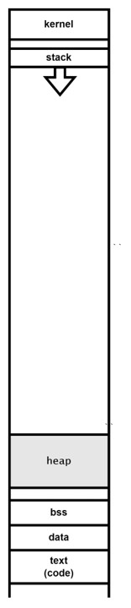
Allocating memory (1 of 3)
Extra material
Typical memory address space (Linux x86-64)
What happens if we allocate memory?
Different library functions:
malloc (+ friends) versus mmap
Different syscalls:
brk, sbrk versus mmap
Notes:
Long Description:
The illustration is a rectangle with many slots. The labelings are as follows from top to bottom. Kernel, stack, heap, b s s, data, and text start parenthesis code end parenthesis.

Slide 77
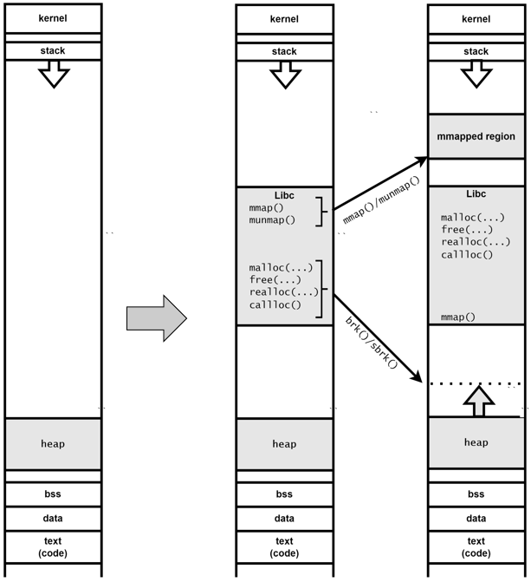
Allocating memory (2 of 3)
Extra material
On Linux, malloc() results in
(s)brk() syscall for small areas
mmap() syscall for large areas
mmap() always results in mmap()
Notes:
Long Description:
On the left, it shows a rectangle with many slots. The labelings are as follows from top to bottom. Kernel, stack, heap, b s s, data, and text start parenthesis code end parenthesis. An arrow points toward a rectangle in the middle. The labelings on the rectangle are as follows from top to bottom. Kernel, stack, mmapped region, libc, heap, b s s, data, and text start parenthesis code end parenthesis.
The code on libc slot is as follows.
malloc left parenthesis ellipsis right parenthesis
free left parenthesis ellipsis right parenthesis
realloc left parenthesis ellipsis right parenthesis
callloc left parenthesis right parenthesis
Two arrows point from lib slot to the third rectangle on the right. The top arrow is labeled as mmmap left parenthesis right parenthesis forward slash munmap left parenthesis right parenthesis while the bottom arrow is labeled as brk left parenthesis right parenthesis forward slash sbrk left parenthesis right parenthesis. The third rectangle also has many slots. The labelings are as follows from top to bottom. Kernel, stack, mmapped region, libc, heap, b s s, data, and text start parenthesis code end parenthesis.
The code on libc slot is as follows.
malloc left parenthesis ellipsis right parenthesis
free left parenthesis ellipsis right parenthesis
realloc left parenthesis ellipsis right parenthesis
callloc left parenthesis right parenthesis
mmap left parenthesis right parenthesis "

Slide 78
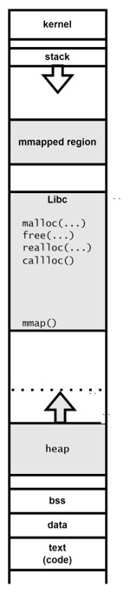
Allocating memory (3 of 3)
Extra material
For all of the memory holds:
access a location in memory
M M U
may trigger P F
may trigger S E G V
For instance, Linux maintains a doubly linked list of V M A s (Virtual Memory Areas) indicating which regions are allocated
Allocating virtual memory versus assigning physical memory
O S may “allocate memory” (enter it as used in its administration) without assigning physical memory to it yet
A physical page frame is assigned only when the program
accesses a location on the virtual page
demand paging
Notes:
Long Description:
The illustration is a rectangle with many slots. The labelings are as follows from top to bottom. Kernel, stack, mmapped region, libc, heap, b s s, data, and text start parenthesis code end parenthesis.
The code on libc slot is as follows.
malloc left parenthesis ellipsis right parenthesis
free left parenthesis ellipsis right parenthesis
realloc left parenthesis ellipsis right parenthesis
callloc left parenthesis right parenthesis
mmap left parenthesis right parenthesis

Slide 79
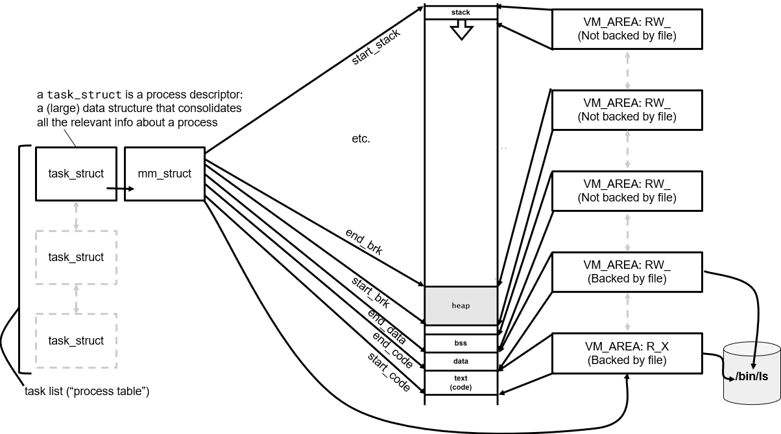
V M A s in Linux (simplified)
Extra material
Notes:
In case students are curious, explain that the task_struct can be easily found in the kernel. It is allocated (via the slab allocator, incidentally) and pointed to by a field in another structure, struct thread_info, allocated (also through the slab allocator) at the bottom of the stack
Long Description:
On the left, there are three rectangles labeled as task underscore struct that point toward each other with an arrow. A rectangle labeled as mm underscore struct follows the top rectangle. The labeling on the top reads a task underscore struct is a process descriptor: a left parenthesis large right parenthesis data structure that consolidates all the relevant info about a process. The labeling at the bottom reads task list left parenthesis double quotation process table double quotation right parenthesis. In the middle, a rectangle is divided into 7 sections labeled from top to bottom as a stack, a downward arrow, a heap, an empty section, b s s, data, and text left parenthesis code right parenthesis. An arrow from mm underscore struct to stack is labeled as start underscore stack, another arrow from mm underscore struct to the heap is labeled as end underscore break, another arrow from mm underscore struct to the heap is labeled as start underscore brk, another arrow from mm underscore struct to b s s is labeled as end underscore data, another arrow from mm underscore struct to data is labeled as end underscore code, and another arrow from mm underscore struct to text is labeled as start underscore code. On the right side, 5 rectangles labeled from top to bottom as V M underscore AREA colon R W underscore left parenthesis not backed by file right parenthesis, V M underscore AREA colon R W underscore left parenthesis not backed by file right parenthesis, V M underscore AREA colon R W underscore left parenthesis not backed by file right parenthesis, V M underscore AREA colon R W underscore left parenthesis backed by file right parenthesis, and V M underscore AREA colon R underscore X left parenthesis backed by file right parenthesis points toward stack, heap, b s s, data, and text on the middle rectangle. The last two rectangles point toward a cylinder on the right labeled as forward slash bin forward slash l s.

Slide 80
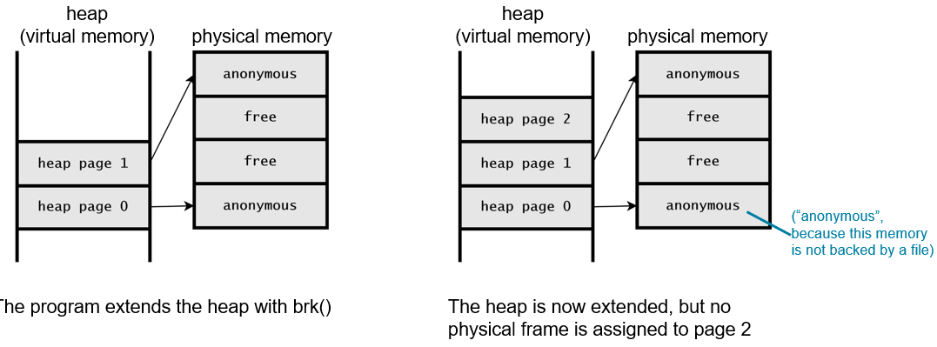
Demand Paging (1)
Extra material
Notes:
Long Description:
The left part of the first illustration labeled as heap virtual memory has two slots labeled as follows. Heap page 1 and heap page 0. The right part of the illustration labeled as physical memory first has four slots labeled as follows from top to bottom. Anonymous, free, free, and anonymous. A pointer points from heap page 1 from left part to anonymous of right part of the illustration. Another pointer points from heap page 0 from left part to anonymous of right part of the illustration. The text at the bottom reads the program eextends the heap with b r k parenthesis. The left part of the second illustration labeled as heap virtual memory has three slots labeled as follows. Heap page 2, heap page 1 and heap page 0. The right part of the illustration labeled as physical memory first has four slots labeled as follows from top to bottom. Anonymous, free, free, and anonymous. A pointer points from heap page 1 from left part to anonymous of right part of the illustration. Another pointer points from heap page 0 from left part to anonymous of right part of the illustration. A line points towards anonymous is labeled as left parenthesis double quotation anonymous double quotation, because this memory is not backed by a file right parenthesis. the text at the bottom reads the heap is now extended, but no physical frame is assigned to page 2.

Slide 81
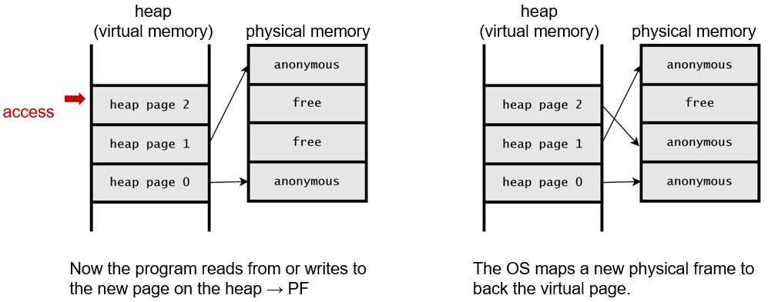
Demand Paging (2)
Extra material
Notes:
Long Description:
The left part of the first illustration labeled as heap virtual memory has three slots labeled as follows. Heap page 2, heap page 1 and heap page 0. The right part of the illustration labeled as physical memory first has four slots labeled as follows from top to bottom. Anonymous, free, free, and anonymous. A pointer points from heap page 1 from left part to anonymous of right part of the illustration. Another pointer points from heap page 0 from left part to anonymous of right part of the illustration. The text at the bottom reads now the program reads from or writes to the new page on the heap tends to P F. The left part of the second illustration labeled as heap virtual memory has three slots labelled as follows. Heap page 2, heap page 1 and heap page 0. The right part of the illustration labeled as physical memory first has four slots labeled as follows from top to bottom. Anonymous, free, anonymous, and anonymous. A pointer points from heap page 2 from left part to anonymous of right part of the illustration. Another pointer points from heap page 1 from left part to anonymous of right part of the illustration. The last pointer points from heap page 0 from left part to anonymous of right part of the illustration. The text at the bottom reads the O S maps a new physical frame to back the virtual page.

Slide 82
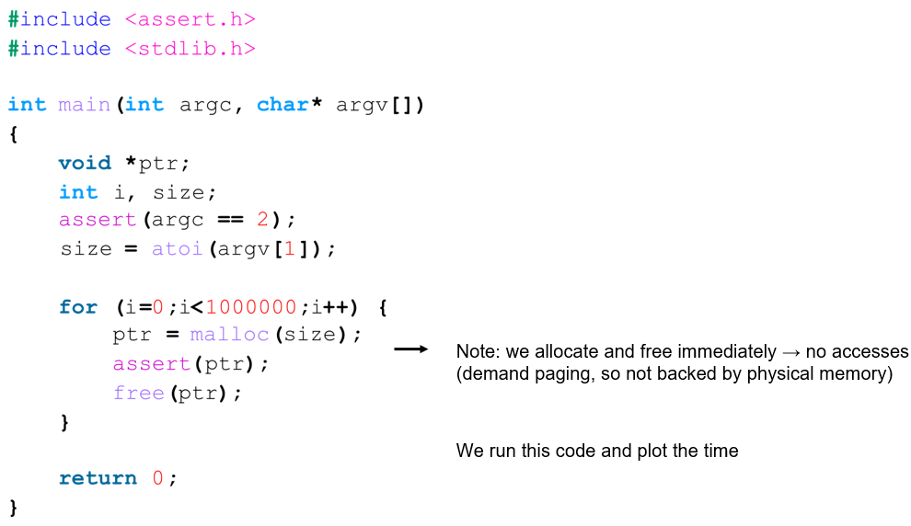
Demand Paging: Linux Allocation Benchmark (1 of 2)
Extra material
Notes:
Long Description:
The code from top to bottom is as follows.
hash include left angle bracket assert dot h right angle bracket
hash include left angle bracket stdlib dot h right angle bracket
int main left parenthesis int arg c comma char asterisk arg v square brackets right parenthesis
left brace
void asterisk p t r semicolon
int i comma size semicolon
assert left parenthesis arg c equals equals 2 right parenthesis semicolon
size equals a t o i left parenthesis arg v left square bracket 1 right square bracket right parenthesis semicolon
for left parenthesis i equals 0 semicolon i is less than 1 0 0 0 0 0 0 semicolon i plus plus right parenthesis left brace
p t r equals malloc left parenthesis size right parenthesis semicolon
assert left parenthesis p t r right parenthesis semicolon
free left parenthesis p t r right parenthesis semicolon
right brace
return 0 semicolon
The text on the right side reads note: we allocate and free immediately no accesses left parenthesis demand paging, so not backed by physical memory right parenthesis. We run this code and plot the time.

Slide 83
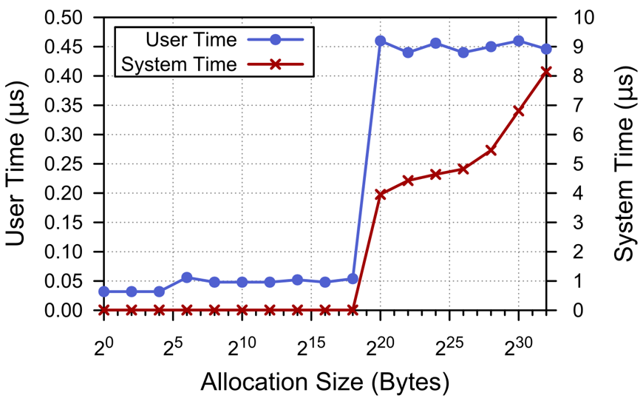
Demand Paging: Linux Allocation Benchmark (2 of 2)
Extra material
Notes:
Explanation (default allocator→ glibc malloc → based on ptmalloc):
For small sizes: no system time → there are no system calls, all handled by library
For very small sizes, allocation are highly optimised in the allocators. In particular, they are satisfied from a special, highly optimised data structure called Fast Bin, a list of caches for small objects (e.g., 16 B, 24 B, etc.)
We see a small hike at 2^6 where we no longer use the very efficient fast bin.
At 2^20 (1M B) we see the first system call and both user time and system time shoot up. This is where malloc does mmap.
User time goes up initially → malloc is a bit less efficient, but from now on, the user time stays (more or less) constant, as one would expect.
However, the system time keeps rising. Why? Hint: it is not because of the mallocs, but because of the frees→munmap(), which require walking the page tables to look for entries and then remove them)
I am not sure why the system time seems to plateaus a bit (roughly between 1 M B and 64 M B)...?
Long Description:
The key at the top left corner shows user time with a blue line passing through a circle and system time with a red line passing through a cross mark. The line graph of user time passes through the points (0, 0 point 0 3), (2 squared, 0 point 0 3), (2 to the fourth power, 0 point 0 3), (2 to the sixth power, 0 point 0 5), (2 to the eight power, 0 point 0 5), 2 to the tenth power, 0 point 0 5), (2 to the twelfth power, 0 point 0 5), (2 to the fourteenth power, 0 point 0 5), (2 to the sixteenth power, 0 point 0 5), (2 to the eighteenth power, 0 point 0 5), (2 to the twentieth power, 0 point 4 6), (2 to the twenty-second power, 0 point 4 4), (2 to the twenty-fourth power, 0 point 4 5), (2 to the twenty-sixth power, 0 point 4 4), (2 to the power twenty-eighth power, 0 point 4 5), ( 2 to the thirtieth power, 0 point 4 6), and (2 to the thirty-second power, 0 point 4 5). The line graph of system time passes through the points (0, 0), (2 squared, 0), (2 to the fourth power, 0), (2 to the sixth power, 0), (2 to the eight power, 0), 2 to the tenth power, 0), (2 to the twelfth power, 0), (2 to the fourteenth power, 0), (2 to the sixteenth power, 0), (2 to the eighteenth power, 0), (2 to the twentieth power, 4), (2 to the twenty-second power, 4 point 2), (2 to the twenty-fourth power, 4 point 3), (2 to the twenty-sixth power, 4 point 4), (2 to the twenty-eighth power, 5 point 2), ( 2 to the thirtieth power, 6 point 8), and (2 to the thirty-second power, 8 point 1).

Slide 84
Design Issues: Allocation Policies
Local allocation:
Replaces only pages of the current process
Assumes static process memory allocation size
Problems:
A growing working set leads to trashing
A shrinking working set leads to wasted memory
Global allocation:
Replaces pages owned by any process. Strategies:
Treat every global page equally (or prioritize)
Dynamic memory balancing using working set size estimation
Selectively swap out processes (or O O M kill)

Slide 85
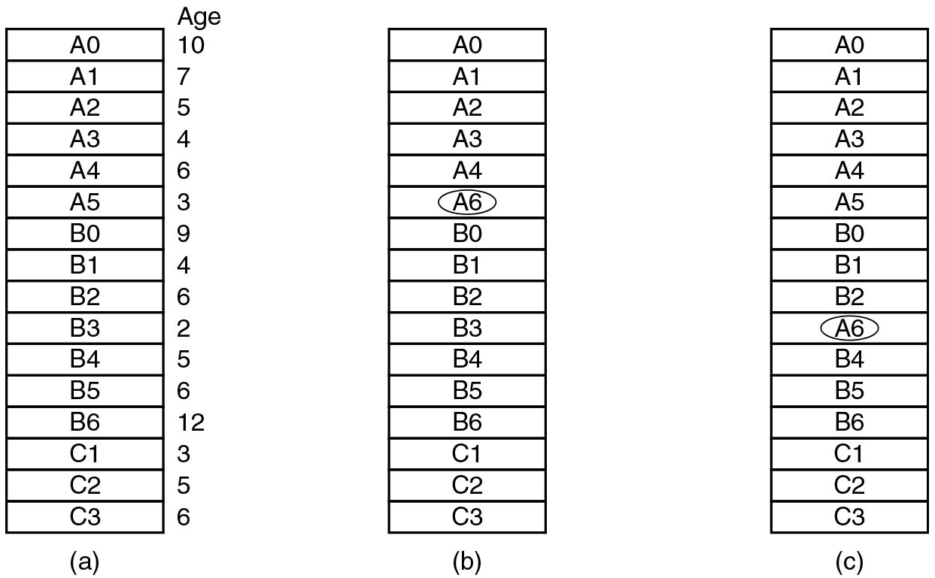
Design Issues: Local versus Global Allocation Policies (1)
Figure 3.22 Local versus global page replacement. (a) Original configuration. (b) Local page replacement. (c) Global page replacement.
Notes:
Long Description:
All the three parts consist of a block having 16 rows.
Part (a): The row entries from top to bottom are as follows: A 0, A 1, A 2, A 3, A 4, A 5, B 0, B 1, B 2, B 3, B 4, B 5, B 6, C 1, C 2, and C 3. The ages of the rows are labeled as follows: 10, 7, 5, 4, 6, 3, 9, 4, 6, 2, 5, 6, 12, 3, 5, 6.
Part (b): The row entries from top to bottom are labeled as follows: A 0, A 1, A 2, A 3, A 4, A 6, B 0, B 1, B 2, B 3, B 4, B 5, B 6, C 1, C 2, and C 3. Row A 3 is circled.
Part (c): The row entries from top to bottom are labeled as follows: A 0, A 1, A 2, A 3, A 4, A 5, B 0, B 1, B 2, A 6, B 4, B 5, B 6, C 1, C 2, and C 3. Row A 6 is circled.

Slide 86
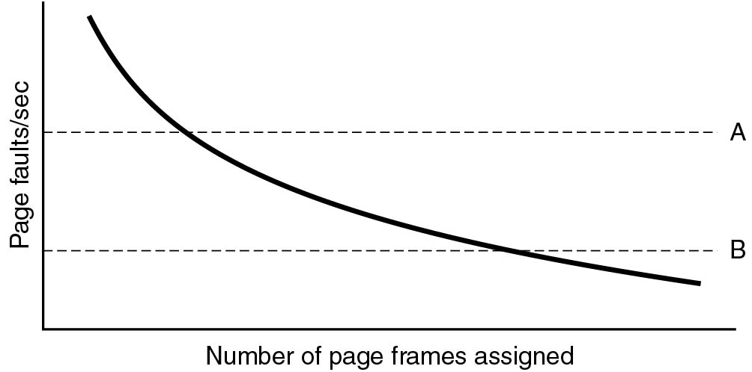
Design Issues: Local versus Global Allocation Policies (2)
Figure 3.23 Page fault rate as a function of the number of page frames assigned.
Notes:
Long Description:
The horizontal axis is labeled number of page frames assigned and the vertical axis is labeled page faults per second. The curve starts at the upper left end of the first quadrant, moves down toward the lower right and ends at the lower right end. Two horizontal dashed lines labeled "A" and B are also plotted to intersect the line.

Slide 87
Design Issues: Load Control
Thrashing can be expected when the combined working sets of all processes exceed the capacity of memory
Out of Memory killer (O O M) selectively kills processes when system is low memory
Less drastic approach swaps some processes to nonvolatile storage and releases those pages
Similar to two-level scheduling
Can also reduce memory usage via compaction/compression
Deduplication or same page merging

Slide 88
Design Issues: Page Size
Most paging systems support 4K B pages
relatively small: limits internal fragmentation / space wastage
not too small: limits number of pages to handle, entries in T L B
In addition, many support also larger pages. For instance:
2 M B
1G B

Slide 89
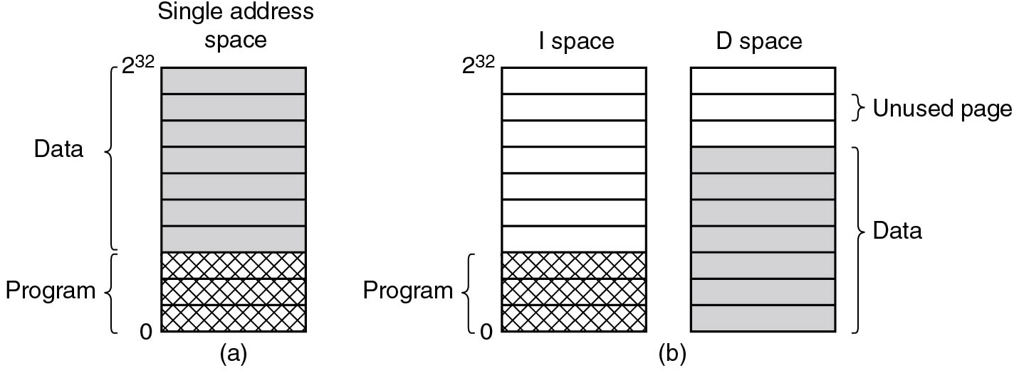
Design Issues: Separate Instruction and Data Spaces
Most computers have a single address space shared by program and data in the past some systems had a separate address space for instructions and data
Figure 3.24 (a) One address space. (b) Separate I and D spaces.
Nowadays, we still see separate I and D spaces in caches and T L B s, etc.
Notes:
Long Description:
All the three parts consist of three blocks having ten blank rows. The first block labeled single address space contains the top seven shaded rows labeled data and the other three rows are labeled program and shaded with diagonal lines. The second block labeled I space contains seven unshaded rows. The last three rows are labeled program and shaded with diagonal lines. The third block labeled D space contains three unshaded rows labeled unused page and the other seven shaded rows are labeled data. The address space of each block ranges from 0 to 2 raised to 32 power.

Slide 90
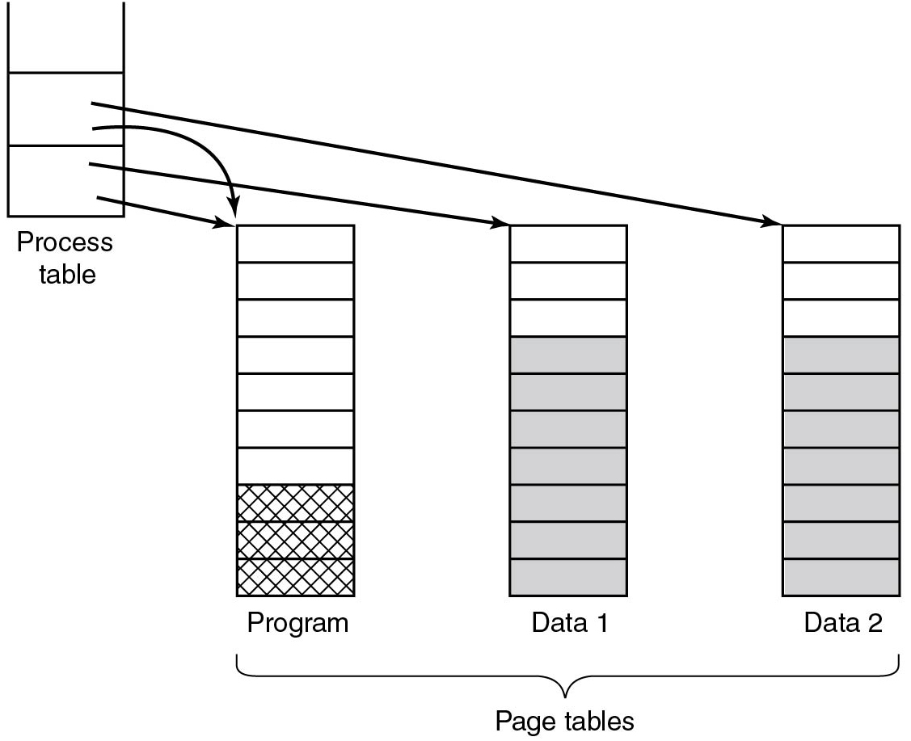
Design Issues: Shared Pages (1 of 2)
Sharing improves efficiency.
When one process exits, O S should realize there is another user of the the page
Figure 3.25 Two processes sharing same page table.
Notes:
Long Description:
Four vertical blocks are labeled process table, program, data 1 and data 2 from left to right. The blocks except the first one are together labeled page tables. The first table is placed at the upper left of the other three tables and consists of three rows. The second table consists of ten rows out of which last three bottom rows are shaded. The third and fourth block consists of ten rows in which the rows four to ten are shaded. Two arrows from the second row of the process block point to the program and data 2 block. Another two arrows from the third row of the process table block point to the program and data 1 block.

Slide 91
Design Issues: Shared Pages (2 of 2)
Sharing improves efficiency.
When one process exits, O S should realise there is another user of the the page
Sharing data is trickier than sharing code
After fork system call parent and child share program and text
To do so efficiently, each gets its own set page table, pointing to the same pages
Pages are mapped read-only
When a process writes to such a page: make a copy
This is known as copy-on-write
Figure 3.25. Two processes sharing same page table.
Notes:
Long Description:
Four vertical blocks are labeled process table, program, data 1 and data 2 from left to right. The blocks except the first one are together labeled page tables. The first table is placed at the upper left of the other three tables and consists of three rows. The second table consists of ten rows out of which last three bottom rows are shaded. The third and fourth block consists of ten rows in which the rows four to ten are shaded. Two arrows from the second row of the process block point to the program and data 2 block. Another two arrows from the third row of the process table block point to the program and data 1 block.

Slide 92
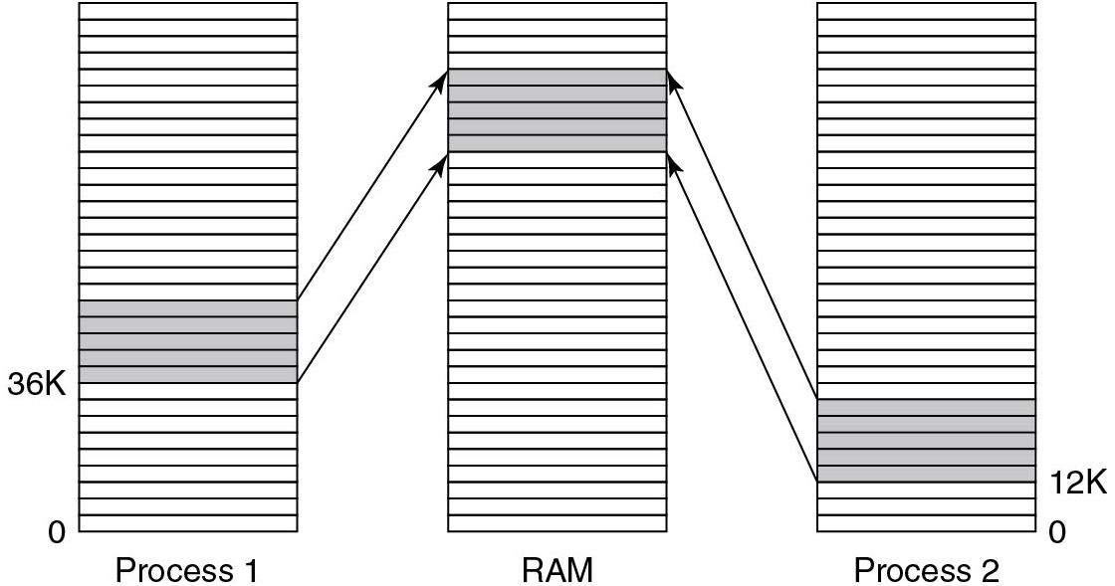
Design Issues: Shared Libraries
Sharing libraries is very common
easy: read-only
Typically through Dynamic Link Libraries (D L L s)
often as position-independent code
Figure 3.26 A shared library being used by two processes.
Notes:
Long Description:
Three vertical blocks containing thirty two rows are labeled process 1, R A M, and process 2 from left to right. The bottom row of the first and last block is marked 0. The rows from 10 to 14 are shaded in process 1 block and the tenth row is labeled 36 k. The rows from 24 to 28 are shaded in R A M block. The rows from 4 to 8 are shaded in process 2 block and the fourth row is labeled 12 k. The shaded rows of first and third block are connected to the shaded rows of the second block using two arrows.

Slide 93
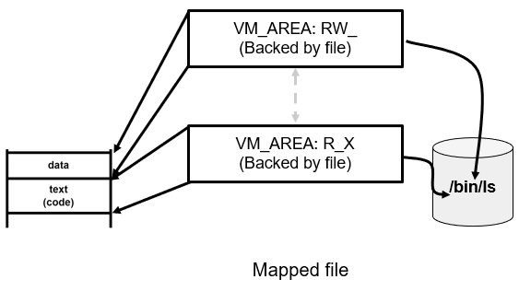
Design Issues: Memory Mapped Files
Shared libs special cases of memory mapped files
As pages are touched
demand paged from disk
When process exits
write dirty pages back to disk
Notes:
Long Description:
The illustration is labeled as mapped file. On the left, a rectangle with two slots from top to bottom are labeled as data and text left parenthesis code right parenthesis. Two rectangles in the middle are labeled as V M underscore AREA colon R W underscore left parenthesis backed by file right parenthesis and V M underscore AREA colon R underscore X left parenthesis backed by file right parenthesis. The top rectangle point toward the data slot on the left while the bottom rectangle point toward the text slot. They both point toward each other with an arrow and toward a cylinder on the right. The cylinder is labeled as forward slash bin forward slash l s.

Slide 94
Design Issues: Cleaning Policy
Paging works well if plenty of free pages. What if we run short?
Indirect reclaim: Paging daemon sleeps and then evicts pages if free pages are in short supply
Leaves them in memory -- easy reuse

Slide 95
Design Issues: Virtual Memory Interface
Allocator interface
malloc family, mmap family
Memory-mapped files
Treat files as memory objects for faster I/O
Facilitate code sharing for programs/shared libraries
Copy-on-write semantics
Lazy copying for fork(), deduplication, checkpointing, etc.
Shared memory
MAP_SHARED mappings, key-based, file-based
Distributed shared memory
Shared memory semantics over the network

Slide 96
Page Fault Handling (1)
The hardware traps to kernel, saving program counter on stack.
Assembly code routine started to save registers and other volatile info. Calls the page fault handler
System discovers page fault has occurred, tries to discover which virtual page needed
Once virtual address caused fault is known, system checks to see if address valid and the protection consistent with access

Slide 97
Page Fault Handling (2)
If frame selected dirty, page is scheduled for transfer to nonvolatile storage, context switch takes place, suspending faulting process
As soon as frame clean, operating system looks up disk address where needed page is, schedules disk or S S D operation to bring it in.
When disk or S S D interrupt indicates page has arrived, tables updated to reflect position, and frame marked as being in normal state.

Slide 98
Page Fault Handling (3)
Faulting instruction backed up to state it had when it began and program counter is reset
Faulting process is scheduled, operating system returns to routine that called it.
Routine reloads registers and other state information, returns to user space to continue execution where it left off

Slide 99
Separation of Policy and Mechanism (1)
The separation is important for managing the complexity of the system.
Not always trivial. Example:
Memory management system is divided into three parts
A low-level M M U handler.
A page fault handler that is part of the kernel.
An external pager running in user space.

Slide 100

Separation of Policy and Mechanism (2)
Kernel page fault handler:
Machine independent
Contains mechanism for paging
External pager:
Machine independent
Can implement the policy
Not always easy.
Cleanest if replacement algorithm in ext. pager
But may not have access to R and M bits
Either need new way to pass bits to user space
Or replacement algorithm in kernel
Figure 3.29 Page fault handling with an external pager.
Notes:
Long Description:
The figure shows a rectangular block labeled main memory which is divided into two layers. The first layer is labeled user space and consists of two circles labeled user process and external pager. The second layer is labeled kernel space and consists of two circles labeled fault handler and M M U handler. A cylinder labeled disk is shown next to the block. The steps are given as follows:
1. An arrow labeled page fault points downward from the user process.
2. An arrow labeled needed page points from the fault handler to the external pager.
3. An arrow labeled request page points from external page to disk.
4. Another arrow labeled page arrives points from the disk to the external pager.
5. An arrow labeled here is page points from the external page to the fault reminder.
6. An arrow labeled map page in points from fault handler to M M U handler.

Slide 101
Segmentation: Paging is Not the Only Option (1 of 2)
Motivation: many programs have many dynamic areas.
Examples of tables generated by compiler:
Source text being saved for the printed listing
Symbol table: names and attributes of variables.
Table containing integer and floating-point constants used
Parse tree, syntactic analysis of the program
Stack used for procedure calls within compiler
Areas may bump into each other

Slide 102

Segmentation: Paging is Not the Only Option (2 of 2)
Figure 3.30 In a one-dimensional address space with growing tables, one table may bump into another.
Notes:
Long Description:
It shows a vertical rectangular block with 5 sections. The top section (1) is labeled as a call stack. Section 2 below it is labeled as a parse tree. Section 2 has free space on top and the space below is currently being used by the parse tree. Section 3 is labeled as a constant table. Section 4 is labeled as the source text. Section 5 is labeled as a symbol table. The symbol table has bumped into the source text table. All sections except section 5 show free space on top.

Slide 103

Segmentation: The Idea
Figure 3.31 A segmented memory allows each table to grow or shrink independently of the other tables.
Notes:
Long Description:
The figure consists of five blocks labeled from left to right as segment 0, segment 1, segment 2, segment 3 and segment 4. The first block is labeled symbol table and consists of addresses ranging from 0 k to 20 k in increments of 4 units. The second block is labeled source text and consists of addresses ranging from 0 k to 12 k in increments of 4 units. The third block is labeled constants and has an address 0 k. The fourth block is labeled parse tree and consists of addresses ranging from 0 k to 16 k in increments of 4 units. The fifth block is labeled call stack and consists of addresses ranging from 0 k to 12 k in increments of 4 units.

Slide 104

Implementation of Pure Segmentation
Problem: external fragmentation
Figure 3.33 (a)-(d) Development of checkerboarding. (e) Removal of the checkerboarding by compaction.
Notes:
Long Description:
Part (a): It consists of a block having five rows labeled from bottom to top as follows: Segment 0 (4 k), segment 1 (8 k), segment 2 (5 k), segment 3 (8 k), segment 4 (7 k).
Part (b): It consists of a block having six rows labeled from bottom to top as follows: Segment 0 (4 k), segment 7 (5 k), (3 k), segment 2 (5 k), segment 3 (8 k), segment 4 (7 k). The 3 k row is shaded.
Part (c): It consists of a block having seven rows labeled from bottom to top as follows: Segment 0 (4 k), segment 7 (5 k), 3 k, segment 2 (5 k), segment 3 (8 k), segment 5 (4 k), 3 k. The two rows labeled 3 k is shaded.
Part (d): It consists of a block having eight rows labeled from bottom to top as follows: Segment 0 (4 k), segment 7 (5 k), 13 k, segment 2 (5 k), segment 6 (4 k), (4 k), segment 5 (4 k), 3 k. The rows labeled 3 k, 4 k, 3 k are shaded.
Part (e): It consists of a block having six rows labeled from bottom to top as follows: Segment 0 (4 k), segment 7 (5 k), 3 k, segment 2 (5 k), segment 6 (4 k), (4 k), segment 5 (4 k), (10 k). The row labeled 10 k is shaded.

Slide 105

Segmentation with Paging: M U L T I C S (1)
Figure 3.34 The M U L T I C S virtual memory. (a) The descriptor segment pointed to the page tables.
Notes:
Long Description:
Part (a): The figure consists of three vertical blocks labeled descriptor segment, Page table for the segment 3 and Page table for the segment 1. The descriptor segment block having 36 bits consists of eight rows labeled from bottom to top as follows: Segment 0 descriptor, Segment 1 descriptor, Segment 2 descriptor, Segment 3 descriptor, Segment 4 descriptor, Segment 5 descriptor and Segment 6 descriptor.
The Page table for the segment 3 block consists of four rows labeled from bottom to top as follows. Page 0 entry, Page 1 entry, Page 2 entry, blank.
The Page table for the segment 1 block also consists of four rows labeled from bottom to top as follows. Page 0 entry, Page 1 entry, Page 2 entry, blank. The segment 3 descriptor row of the first block is connected to the page 0 entry of the second block. The segment 1 descriptor row of the first block is connected to page 0 entry of the third block.

Slide 106
Segmentation with Paging: M U L T I C S (2)
Figure 3.34 The M U L T I C S virtual memory. (b) A segment descriptor. The numbers are the field lengths.
Notes:
Long Description:
Part (b): It consists of a horizontal block having seven columns labeled from left to right as follows: Main memory address of the page table, Segment length (in pages), blank, blank, blank, and is shaded, blank, blank.
The bits of the columns are marked 18, 9, 1, 1, 1, 3, 3.
The Page sizes of the columns except the first and second are given as follows. Column 3: 0 equals 1024 words and 1 equals 64 words.
Column 4: 0 equals segment is paged, 1 equals segment is not paged.
Column 6: Miscellaneous bits.
Column 7: Protection bits.

Slide 107

Segmentation with Paging: M U L T I C S (3)
Figure 3.35 A 34-bit M U L T I C S virtual address.
Notes:
Long Description:
The first block is labeled segment number. The second block labeled address within the segment is divided into 2 sections. The left section is labeled page number and the right section is labeled offset within the page. The number of bits for the first and second block are 18, 6, and 10, respectively.

Slide 108

Segmentation with Paging: M U L T I C S (4)
Figure 3.36 Conversion of a two-part M U L T I C S address into a main memory address.
Notes:
Long Description:
Part 1: Two horizontal blocks labeled MULTICS virtual address are shown. The first block is labeled segment number. The second block is divided into segments labeled page number and offset.
Part 2: Three vertical blocks are labeled description segment, page table and page. The first block consists of description, the second block consists of page frame and the third block consists of word which are pointed from left to right. An arrow points upward from each block labeled segment number, page number, and offset, respectively.

Slide 109

Segmentation with Paging: M U L T I C S (5)
Figure 3.37 A simplified version of the M U L T I C S T L B. The existence of two page sizes made the actual T L B more complicated.
Notes:
Long Description:
<html><head><style type="text/css">th{border:1px solid #000}tr th{padding:4px}td{padding:4px}</style></head><body><table border="1"><tr><th colspan="2">Comparison field</th><th rowspan="2">Page frame</th><th rowspan="2">Protection</th><th rowspan="2">Age</th><th rowspan="2">Is the entry used?</th></tr><tr><th>Segment number</th><th>Virtual page</th></tr><tr><td>4</td><td>1</td><td>7</td><td>Read/write</td><td>13</td><td>1</td></tr><tr><td>6</td><td>0</td><td>2</td><td>Read only</td><td>10</td><td>1</td></tr><tr><td>12</td><td>3</td><td>1</td><td>Read/write</td><td>2</td><td>1</td></tr><tr><td></td><td></td><td></td><td></td><td></td><td>0</td></tr><tr><td>2</td><td>1</td><td>0</td><td>Execute only</td><td>7</td><td>1</td></tr><tr><td>2</td><td>2</td><td>12</td><td>Execute only</td><td>9</td><td>1</td></tr></table></body></html>

Slide 110
Paging versus. Segmentation
Consideration | Paging | Segmentation
Need the programmer be aware that this technique is being used? | No | Yes
How many linear address spaces are there? | 1 | Many
Can the total address space exceed the size of physical memory? | Yes | Yes
Can procedures and data be distinguished and separately protected? | No | Yes
Can tables whose size fluctuates be accommodated easily? | No | Yes
Is sharing of procedures between users facilitated? | No | Yes
Why was this technique invented? | To get a large linear address space without having to buy more physical memory | To allow programs and data to be broken up into logically independent address spaces and to aid sharing and protection
Figure 3.32 Comparison of paging and segmentation

Slide 111
Summary
In this chapter, we looked at memory management (M M) in detail
We discussed many core concepts:
Memory abstractions
Virtual memory
Memory allocators
Paging
Page replacement
Segmentation
Design issues
On modern systems memory management can be very complicated
Next, we will look at another core component: file systems!

Slide 112

Copyright
This work is protected by United States copyright laws and is provided solely for the use of instructors in teaching their courses and assessing student learning. Dissemination or sale of any part of this work (including on the World Wide Web) will destroy the integrity of the work and is not permitted. The work and materials from it should never be made available to students except by instructors using the accompanying text in their classes. All recipients of this work are expected to abide by these restrictions and to honor the intended pedagogical purposes and the needs of other instructors who rely on these materials.

